Slide 1
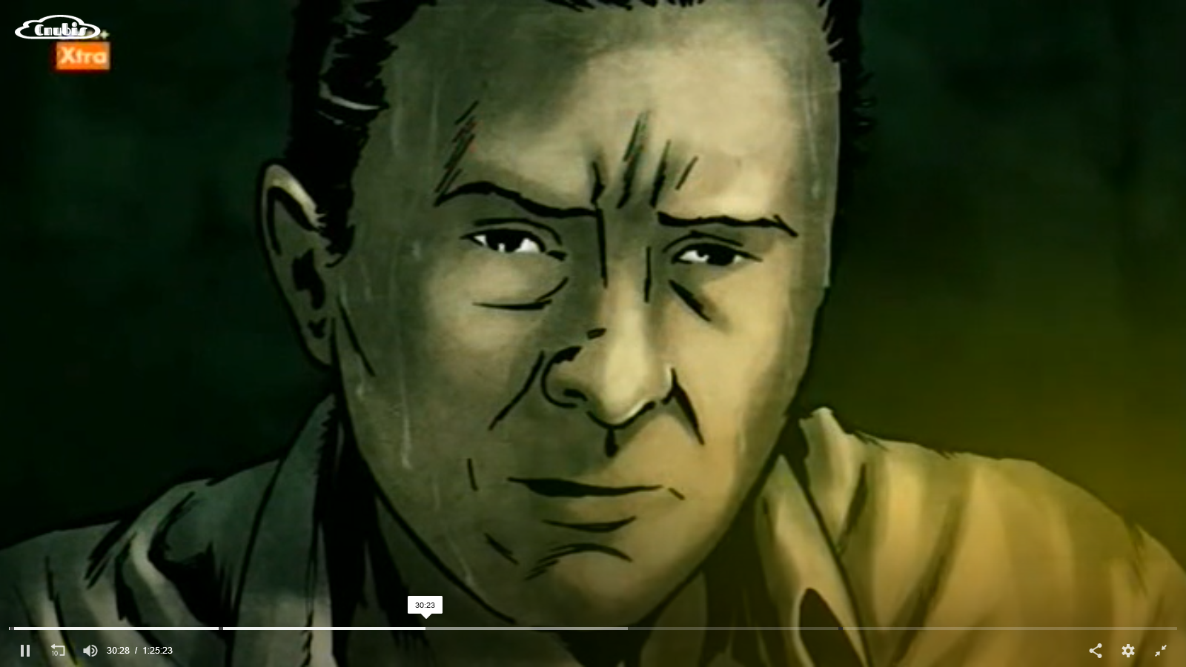
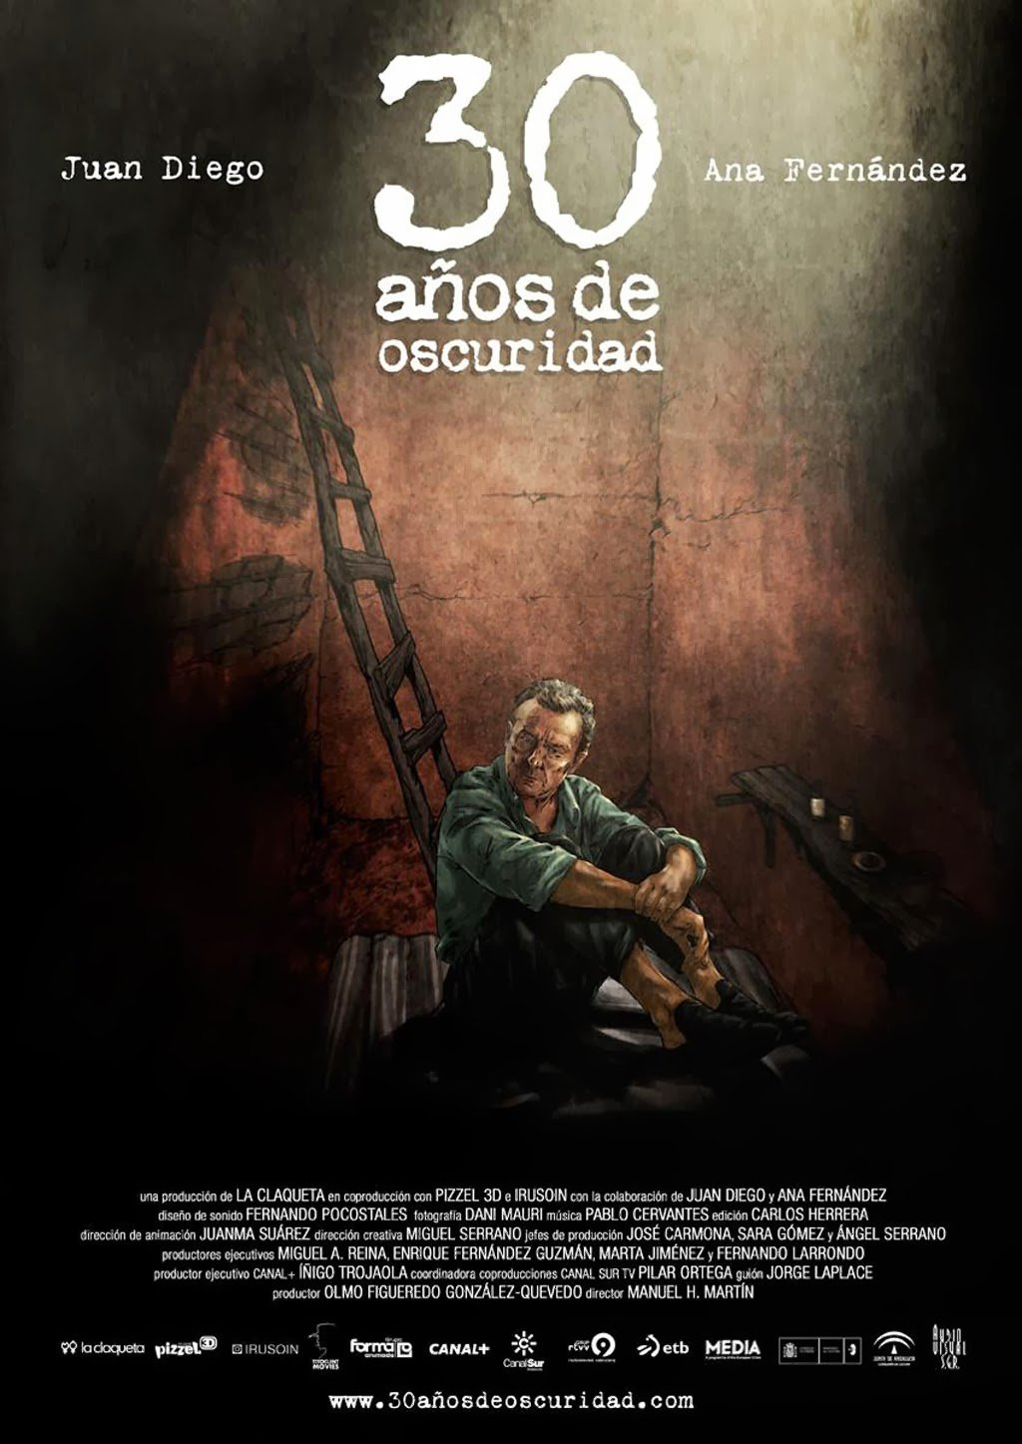
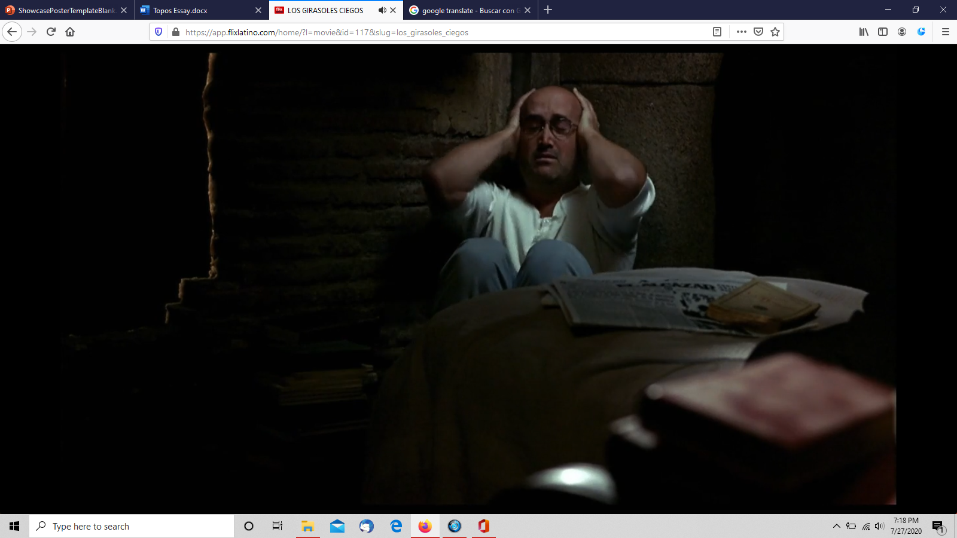
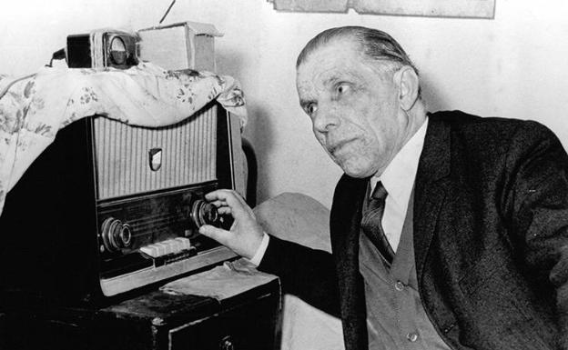
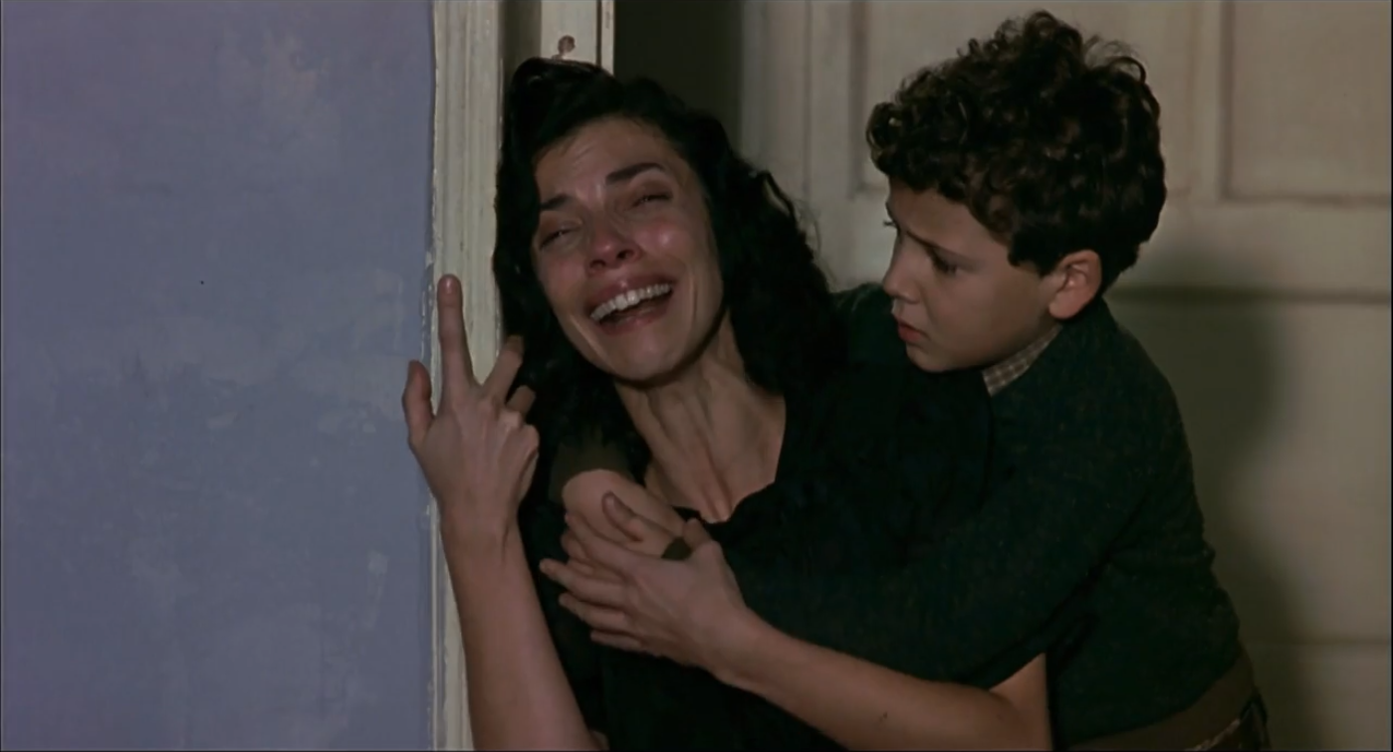
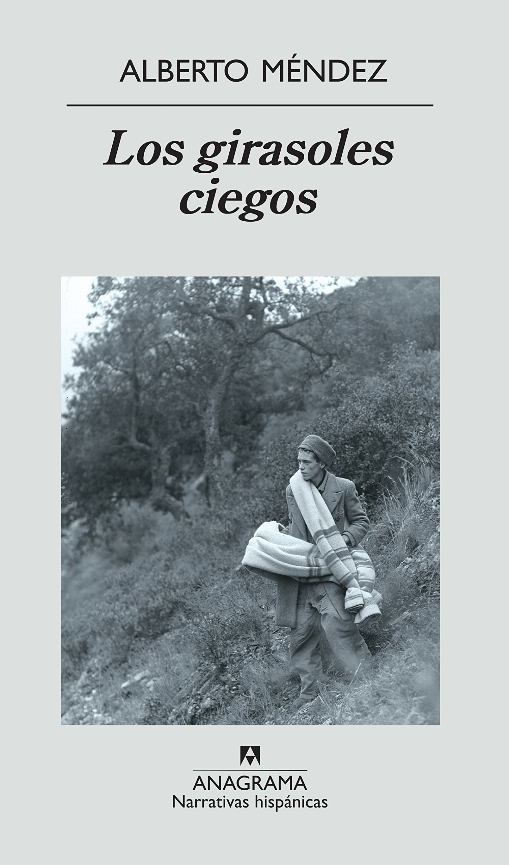
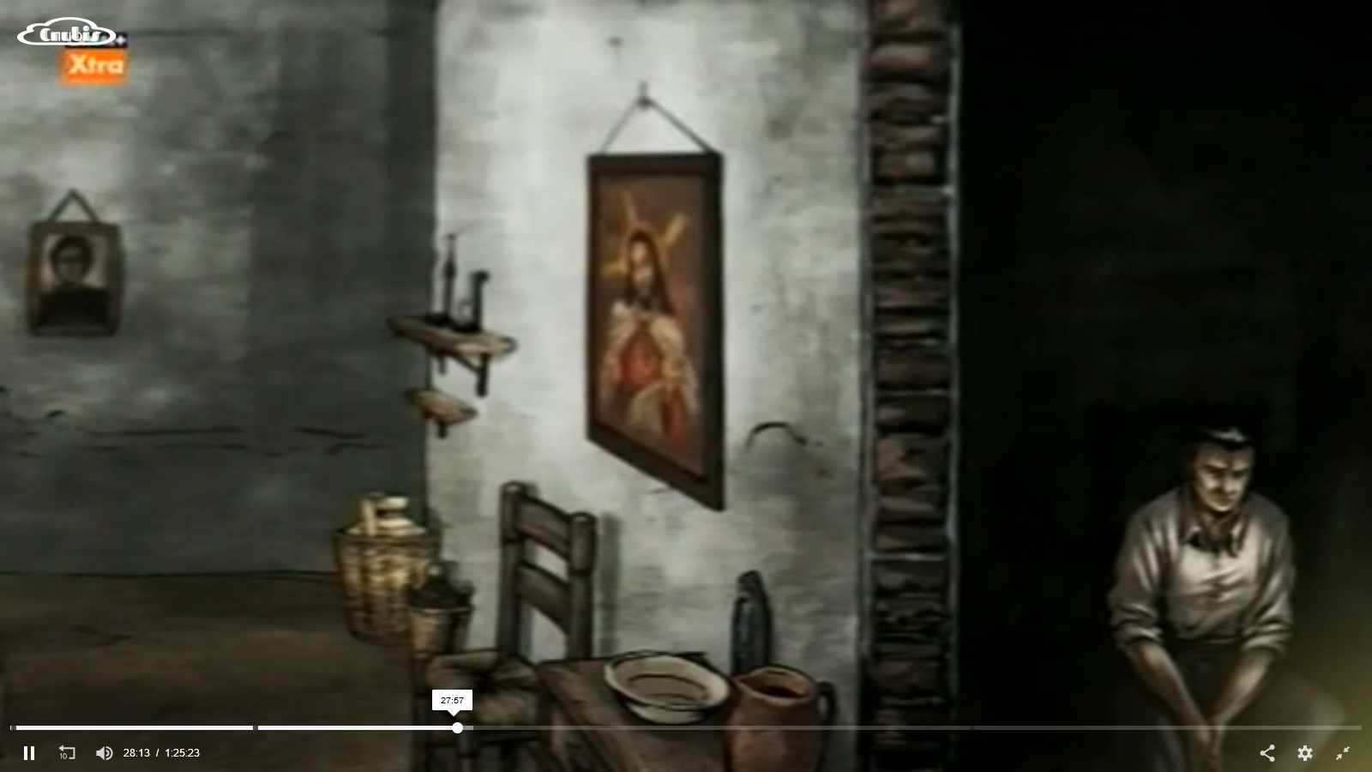
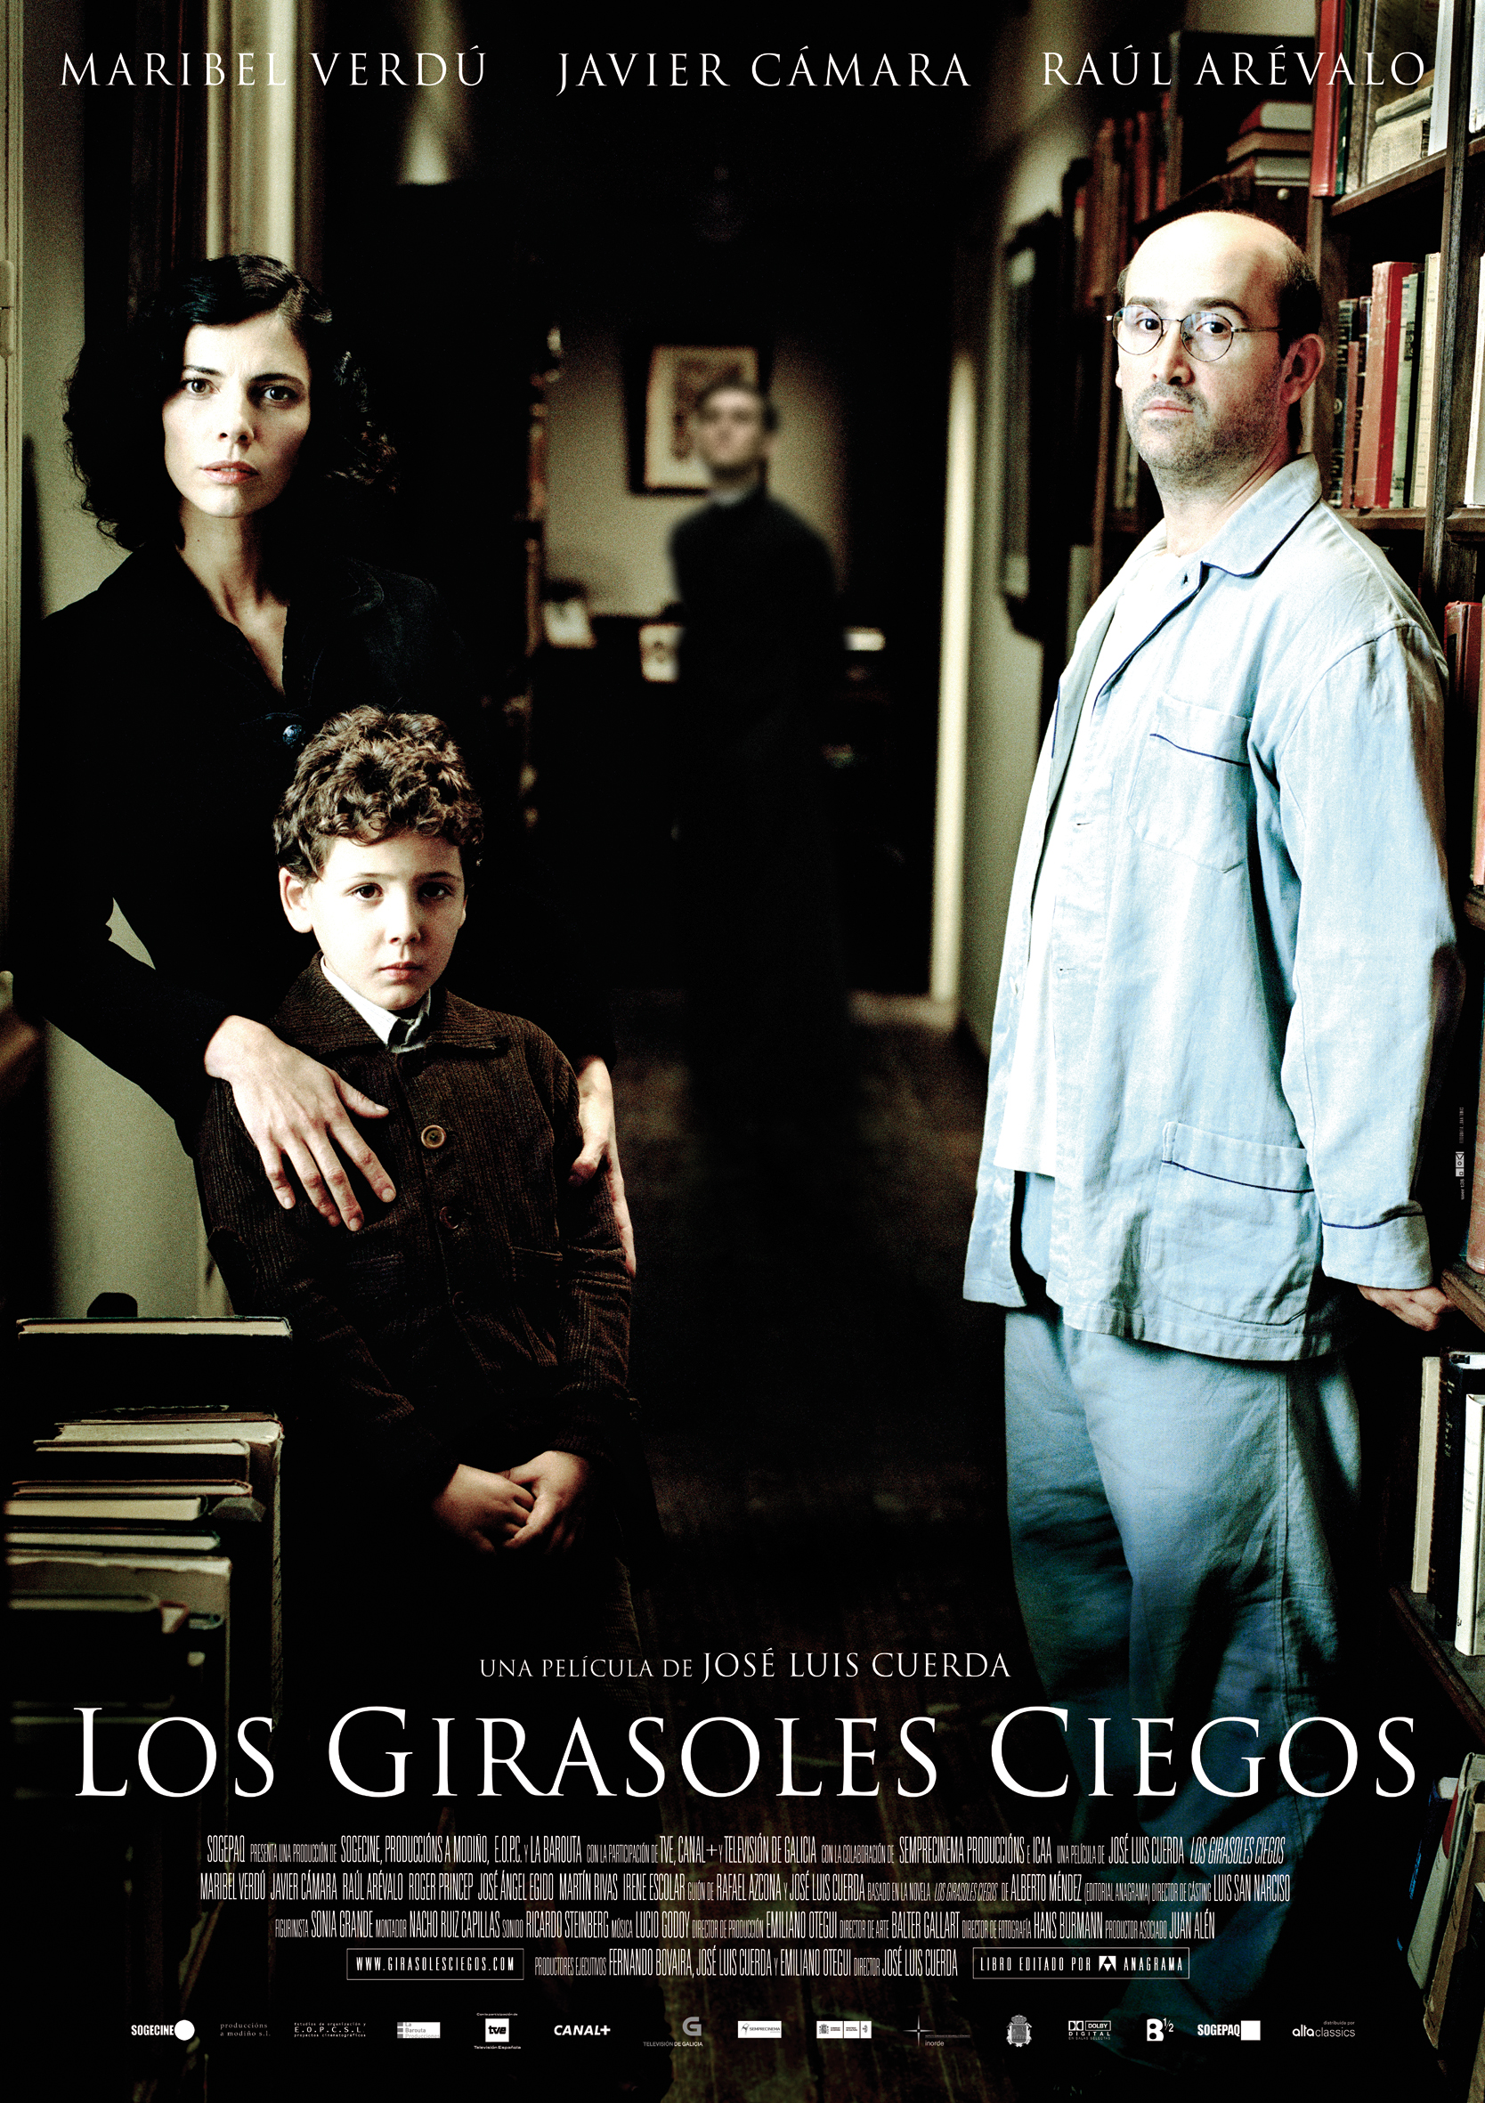
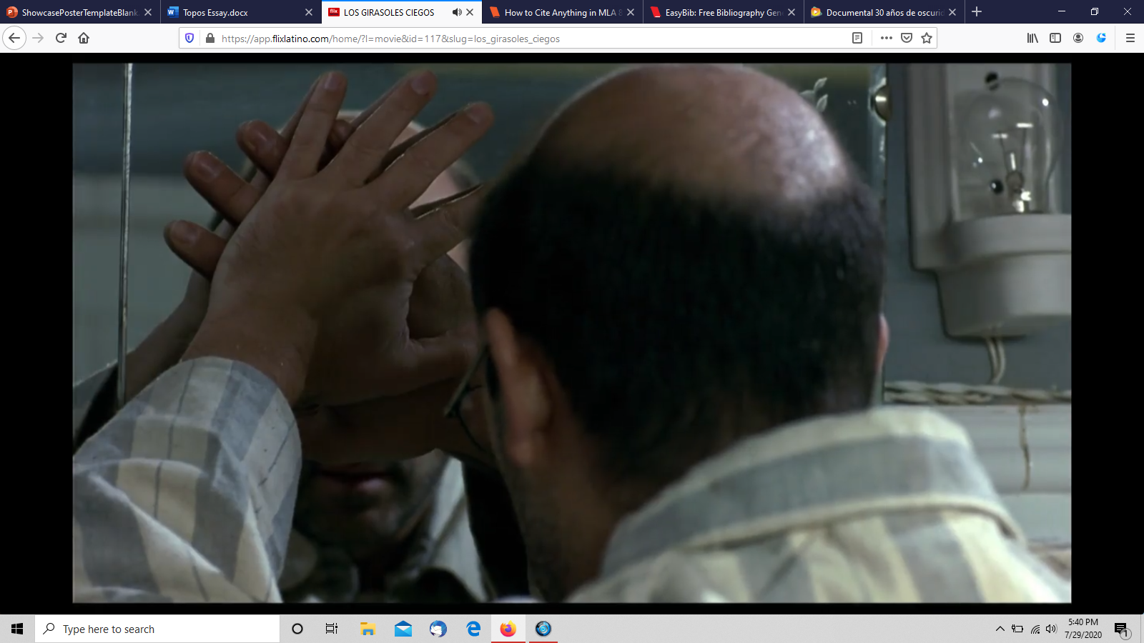
Prisoners of the State and Mind: Remembering Los Topos in Contemporary Spanish Cinema
Investigator: Gabriel E. Galindo
Mentor: Dr. Beatriz Gomez-Acuna
gfgfhghg
sdsfdsdfsfdsfsd
ABSTRACT: Contemporary Spanish films focused on the civil war (1936-1939) and the dictatorship (1939-1975) have been criticized for antagonizing the nationalists, those who followed Franco, and excessively humanizing the memory of the republicans, those defending the democratically elected government. Yet, since the implementation in 2007 of the Historic Memory Law, there also has been criticism on the lack of recognition the victims of Francoist repression have publicly received. The documentary 30 years of Darkness (2012) and the film The Blind Sunflowers (2008) recount the stories of Los Topos, men who hid from the Franco dictatorship in Spain. The purpose of this investigation is to identify and understand the Historic Memory Law’s effects within these films as they uphold and serve its purpose of providing personal recognition and moral restitution towards Los Topos, a severely repressed group of men. This analysis unveils the cinematographic techniques employed in these films that allow the filmmakers to present these men as unsung resistance heroes whose memory deserves to be preserved for future generations.
Keywords: Spanish Civil War, Francisco Franco, Historical Memory Law, 30 years of Darkness, The Blind Sunflowers, Los topos.
INTRODUCTION: From 1939-1975, during the Franco dictatorship in Spain, certain individuals who were classified as war criminals by the State hid in the most unimaginable places. These men, named topos or moles for their inability to see the light of the day, hid from the regime up until the proclamation of amnesty in 1969. In 2007, the modern democratic government of Spain, ruled by the socialist party, implemented the Historic Memory Law with the purpose of recognizing and giving rights to the victims of the civil war and the dictatorship that followed it. The Historic Memory Law impacted the creation/production of films such as Los Girasoles Ciegos and 30 Años de Oscuridad, which dealt with the recognition of personal memories of victims of the Francoist repression. A film analysis that takes into consideration narrative structure, cultural context, and mise-en-scene, unveils the cinematographic techniques employed by filmmakers to present these men as unsung resistance heroes whose memory deserves to be preserved for future generations.
CONCLUSION
This investigation revealed a clear connection between the primary goals of the Historical memory Law and these two films, Further research is needed/recommended to establish other connections with other groups of victims, specially taking into consideration the addendum to the law passed in 2020.
METHOD: TEXTUAL ANALYSIS
This scene from 30 Anos de Oscuridad highlights the fear in Cortes' face as sweat pours throughout it, all while a first-person shot is taken into focus to capture that feeling of terror and tension Topos like him faced in the dictatorship. Cortes lived in constant panic from the authorities and the townspeople, the mental state that this experience left on him was drastic.
hhh
BIBLIOGRAPHY:
Colmenero, Sara Santamaría. “Los Girasoles Ciegos, De Alberto Méndez: ¿Un «Lugar De Memoria» De La Guerra Civil?” Pasajes, no. 24, 2007, pp. 122–129. JSTOR, www.jstor.org/stable/23075898. Accessed 24 July 2020.
Cuerda, Jose Luis, director. Los Girasoles Ciegos. FlixLatino, Estudios Organizativos y Proyectos Cinematográficos S.L., 2008, app.flixlatino.com/home/?l=movie&id=117&slug=los_girasoles_ciegos.
Martin, Manuel H., director. 30 Años De Oscuridad. DocumaniaTV, 39 Escalones, 2012, www.documaniatv.com/historia/30-anos-de-oscuridad-video_0f93fcd31.html.
Méndez Alberto. “Cuarta Derrota.” Los Girasoles Ciegos, by Méndez Alberto, Anagrama, 2004, pp. 64–97.
Mata, Ramón Arnabat. “La Represión: El Adn Del Franquismo Español.” Cuadernos De Historia (Santiago), no. 39, 2013, pp. 33–59., doi:10.4067/s0719-12432013000200002.
Méndez Alberto. “Cuarta Derrota.” Los Girasoles Ciegos, by Méndez Alberto, Anagrama, 2004, pp. 64–97.
Cuerda, Jose Luis, director. Los Girasoles Ciegos. FlixLatino, Estudios Organizativos y Proyectos Cinematográficos S.L., 2008, app.flixlatino.com/home/?l=movie&id=117&slug=los_girasoles_ciegos.
Scene 48:21-52:31
Martin, Manuel H., director. 30 Años De Oscuridad. DocumaniaTV, 39 Escalones, 2012, www.documaniatv.com/historia/30-anos-de-oscuridad-video_0f93fcd31.html.
Scene 27:13-27:35
In this scene from Los Girasoles Ciegos, fear can be seen in the emotions of the character Ricardo Moza, through a median shot where a zenith key light focuses over his reactions as the national guard enters his home searching for him, fearing for the life of his family and himself. This type of scene demonstrates the gravity of the topos' situations.
“Debe tener razón ella, porque no he podido olvidar nunca la mirada de mi padre precipitándose al vacío, su rostro sonriente mientras el patio engullía su cuerpo abandonado”- Los Girasoles Ciegos, pg. 96
- Although not specifically mentioned, this scene physically shows what occurs before Lorenzo asks his mother about his father. Lorenzo is a witness of the Dictatorship and its repression as he sees upfront how it has affected his parents negatively. Something that he has had to live with the rest of his life.
Cuerda, Jose Luis, director. Los Girasoles Ciegos. FlixLatino, Estudios Organizativos y Proyectos Cinematográficos S.L., 2008, app.flixlatino.com/home/?l=movie&id=117&slug=los_girasoles_ciegos.
In this scene, Ricardo covers his face in the mirror. After the recent events and his life in hiding, and with their plans to move away to Portugal, Ricardo feels the urge to “erase” himself from life. This up close first person shot of him covering hi reflection foreshadows his fate, as well as showcase the mental effects of his hiding and his inability to do something for his family since they had to endure all sorts of struggles just so he could still live.
Martin, Manuel H., director. 30 Años De Oscuridad. DocumaniaTV, 39 Escalones, 2012, www.documaniatv.com/historia/30-anos-de-oscuridad-video_0f93fcd31.html.Scene 28:14-29:10.
The scene located center-up portrays how Manuel Cortes had to hide during the first years of the dictatorship. This wide shot reveals how through a painting of Jesus Christ was a small room behind a wall of his father’s home.
Cuerda, Jose Luis, director. Los Girasoles Ciegos. FlixLatino, Estudios Organizativos y Proyectos Cinematográficos S.L., 2008, app.flixlatino.com/home/?l=movie&id=117&slug=los_girasoles_ciegos.

