Slide 1

Research Study of Contact and Aerosol Emissions as Applied to the Band Rehearsal
Emma Germann with Professor Emeritus Judith E. Grimes

Slide 2
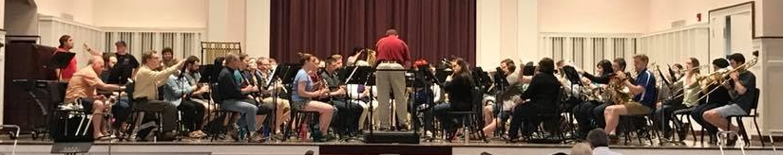




Images from the Facebook pages of Elmhurst College Bands and the personal page of Emma Germann

Slide 3
Who, What, Where, and Why?

Slide 4
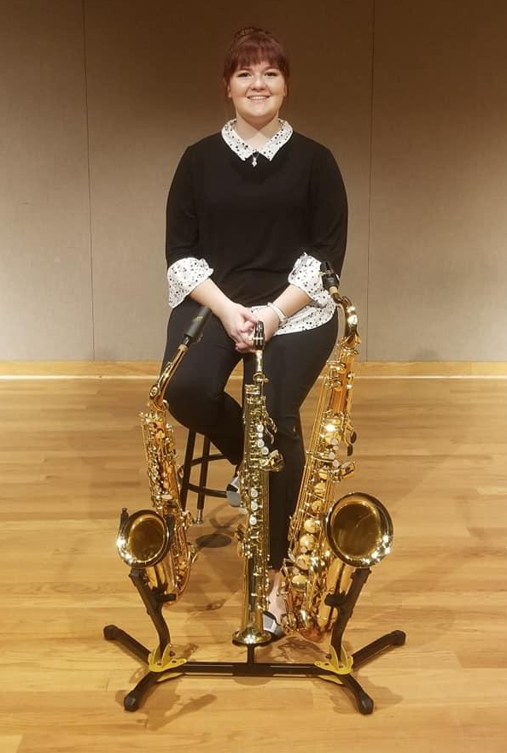

Who are we?
Emma Germann
Music Education Major at Elmhurst University
Student musician of 10 years
Email: egerm6801@365.elmhurst.edu
Judith E. Grimes
Emeritus Professor of Music at Elmhurst University
47 year career in music education
National and international clinician, guest conductor, and adjudicator

Slide 5
Who is this project for?
Student band musicians
What happens if a student attends rehearsal and the director has not properly provided minimum safety precautions?
Student awareness validates what the conscientious director is implementing and empowers students to create a dialogue with directors on how to modify methods
Notes:
Add images

Slide 6
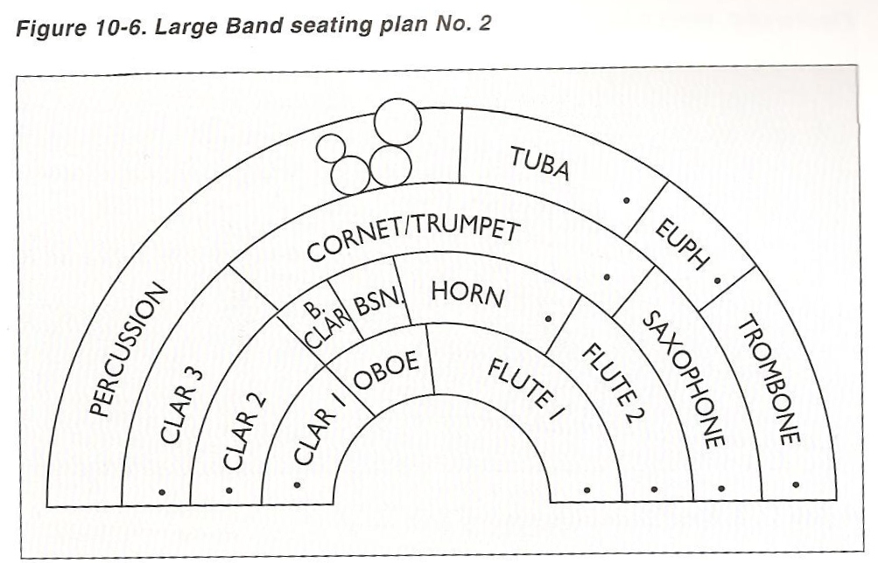

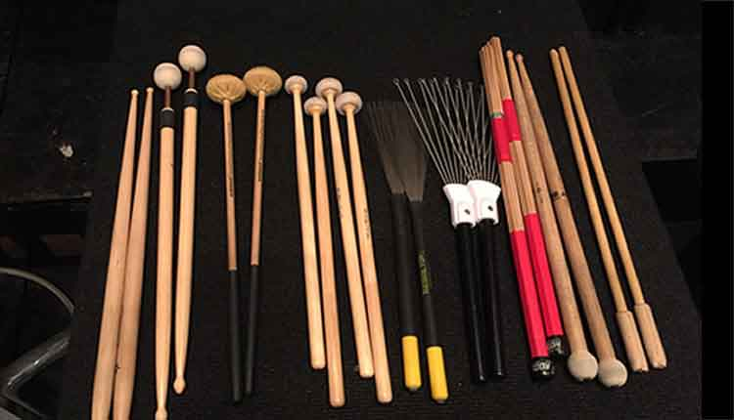
Where are the germs in the band rehearsal?
Instrument-specific sources:
Spit valves, spit slides, reeds, saliva, condensation build up on instruments
Deep breathing air projection
Shared equipment:
Music, music stands, pencils, instrument storage racks, percussion mallets, etc.
Large ensembles in small spaces
Inability to effectively social distance students
https://lrigden.files.wordpress.com/2012/02/seating-chart-2.jpg
https://banddirector.com/wp-content/uploads/Sticks-and-Mallets.jpg
https://qph.fs.quoracdn.net/main-qimg-8fa02486c9f73546676115bdd296a0af.webp
Notes:
https://qph.fs.quoracdn.net/main-qimg-8fa02486c9f73546676115bdd296a0af.webp spit valve
https://banddirector.com/wp-content/uploads/Sticks-and-Mallets.jpg mallets

Slide 7
Abstract

Slide 8
Recommendations for Student Musicians on Minimizing Exposure to COVID-19 Virus in the Band Rehearsal
In the wake of a viral pandemic, student musicians are facing the challenge of returning safely to the band rehearsal. This research survey cataloged, surveyed, and analyzed applicable studies from between March 1st and July 31st. Studies surveyed focused on band rehearsal settings but were not exclusive to students utilizing musical instruments or to virus spread via playing instruments. Conclusions are in the form of recommendations to student musicians on how to minimize their risk of infection in the band rehearsal. These conclusions can serve as a guide to student musicians on how to safely return to the band rehearsal with specific recommendations on how to reduce exposure to aerosol and contact transmission of virus, such as the novel coronavirus.
Specific details in subsequent slides.

Slide 9
What was the method?
Research survey of aerosol and contact emissions
Reading and compilation of published studies, studies currently underway
Includes some preliminary data
Aerosol and contact emissions - germs spread through air and physical contact
Source selection
National and international studies
University studies
Studies commissioned by major musical ensembles and leading music education associations (preliminary data)

Slide 10
Why is this project important? Why now?
Sustainability of music programs depends on the ability to make music in a way that does not risk student musicians’ health
COVID-19 Pandemic
How do student musicians return to making music together?
How to educators keep their students safe?
How can the band rehearsal be conducted in a way that is safe for everyone involved?
Submitting recommendations for publication in the Women Band Director’s International Journal

Slide 11
Recommendations to
Student Band Musicians: General

Slide 12
General Recommendations for all Student Band Musicians Slide 1 of 6
If you are sick or have any of the symptoms of COVID-19, do not attend rehearsal. If you have recently been tested for COVID-19, do not attend rehearsal until you receive a negative test result. Symptoms may include cough, fever, fatigue, shortness of breath, chills, muscle pain, runny nose, sore throat, headache, gastrointestinal symptoms, nausea, abdominal cramps or pain, and loss of sense of smell and/or taste (Hamner, et al, 2020; Spahn & Richter, 2020a; Department of Homeland Security, 2020; Willich, et al., 2020; Indiana State Department of Health, et al., 2020; UK Association for Music Education, 2020; ISBE & IDPH, 2020).
Rehearse outdoors whenever possible. Continue to follow social distancing and personal protection guidelines as established by your state while rehearsing outside (Spahn & Richter, 2020a; HSBDNA, 2020; Indiana State Department of Health, et al., 2020; Morawska, et al., 2020; Anderson, et al., 2020; Miller, 2020; Nishiura, et al., 2020; Qian, et al. 2020; Hamner, et al, 2020; Helfgott, 2020; Spahn & Richter, 2020b; Kähler & Hain, 2020; Weaver, et al., 2020; ISBE & IDPH, 2020).
1-2 of 13

Slide 13
General Recommendations for all Student Band Musicians Slide 2 of 6
When rehearsing inside, ensure that the rehearsal is held in the largest space available to your ensemble. Gymnasiums, auditoriums, large cafeterias, and other large venues are best for social distancing and minimizing the concentration of viral contamination in the air (Spahn & Richter, 2020a; HSBDNA, 2020; Evans, 2020; Anderson, et al., 2020; Liu, et al. 2020; Nishiura, et al., 2020; Qian, et al. 2020; Hamner, et al, 2020; Spahn & Richter, 2020b; Kähler & Hain, 2020; Weaver, et al., 2020; ISBE & IDPH, 2020; NFHS & NAfME, 2020).
Do not hesitate to inquire about the ventilation of the rehearsal space. Inside rehearsal spaces need proper ventilation, filtration, and supply of fresh air from outside. This includes an overhead extracting HVAC system with high quality air filtration, no use of recirculated air, and allowing all windows in the space to be open to the outside air, even when heat or air conditioning is running. Additionally, HEPA filter systems that are intended for the size of the rehearsal space can be placed in the room to supplement HVAC system air filtration (Spahn & Richter, 2020a; UK Association for Music Education, 2020; HSBDNA, 2020; Indiana State Department of Health, et al., 2020; West Point Research Center, 2020; Morawska, et al., 2020; Evans, 2020; Anderson, et al., 2020; Zhao, et al., 2020; Liu, et al. 2020; Qian, et al. 2020; Helfgott, 2020; Spahn & Richter, 2020b; Kähler & Hain, 2020; Weaver, et al., 2020).
3-4 of 13

Slide 14
General Recommendations for all Student Band Musicians Slide 3 of 6
As an individual, ensure that you maintain a 6-foot (2 meter) radius of social distance between yourself and others. More specific guidance on spacing of instruments and seating can be found in the instrument-specific categories below (Spahn & Richter, 2020a; West Point Research Center, 2020; Willich, et al., 2020; Miller, 2020; Department of Homeland Security, 2020; Kähler & Hain, 2020; Kähler & Hain, 2020; Chu, et al., 2020; Weaver, et al., 2020; ISBE & IDPH, 2020; NFHS & NAfME, 2020).
Wear a mask when not playing your instrument. Do not speak without a protective face covering, such as a cloth or surgical mask. Surgical masks are the most effective form of face coverings that are readily available (Spahn & Richter, 2020a; Indiana State Department of Health, et al., 2020; West Point Research Center, 2020; Evans, 2020; Willich, et al., 2020; Clase, et al., 2020; Miller, 2020; Zhao, et al., 2020; Liu, et al. 2020; Department of Homeland Security, 2020; Zhang, et al., 2020; Helfgott, 2020; Spahn & Richter, 2020b; Chu, et al., 2020; Weaver, et al., 2020; ISBE & IDPH, 2020).
5-6 of 13

Slide 15
General Recommendations for all Student Band Musicians Slide 4 of 6
Wash your hands for at least 20 seconds with soap before entering the rehearsal space. If you must leave, re-wash your hands before entering the rehearsal space again. Do not touch your face, other musicians, or other musicians’ instruments or personal belongings. If you do so, you must re-wash your hands (Spahn & Richter, 2020a; Indiana State Department of Health, et al., 2020; West Point Research Center, 2020; Willich, et al., 2020; Miller, 2020; Department of Homeland Security, 2020; Spahn & Richter, 2020b; ISBE & IDPH, 2020).
Do not share your instruments, mouthpieces, music stands, or equipment if at all avoidable. If sharing is necessary, see instrument-specific guidance and follow the most recent sanitization guidelines (Spahn & Richter, 2020a; Indiana State Department of Health, et al., 2020; ISBE & IDPH, 2020; NFHS & NAfME, 2020).
During the rehearsal, make sure that you are arranged and seated facing the front of the room. There should not be any students facing each other, as all musicians should be seated facing the back of the person in front of them (Indiana State Department of Health, et al., 2020; Willich, et al., 2020; Hamner, et al, 2020).
7-9 of 13

Slide 16
General Recommendations for all Student Band Musicians Slide 5 of 6
Do not leave your seat and walk past fellow student musicians during rehearsal. Wait to leave your seat until there is a rehearsal break or for the conclusion of rehearsal when the ensemble exits in an orderly fashion (Indiana State Department of Health, et al., 2020; West Point Research Center, 2020; Willich, et al., 2020).
Remind your director to take frequent breaks from rehearsing as a group. Your director should know the frequency of breaks depending on the size and ventilation rates of your rehearsal space. When possible, the ensemble should leave the room and allow time for the air to be replaced or filtered so as to become less concentrated with potential viral load (Spahn & Richter, 2020a; West Point Research Center, 2020; Weaver, et al., 2020).
10-11 of 13

Slide 17
General Recommendations for all Student Band Musicians Slide 6 of 6
Do not congregate or gather in groups in instrument storage spaces or during rehearsal breaks. Instrument storage rooms should be entered and exited in one direction as a single-file line, with the number of musicians in the space limited based on the ability to maintain a radial distance of 6 feet between musicians. Storage areas that are not self-contained (such as instrument locker areas) should also limit the number of musicians that can be in the area according to the ability to maintain 6 feet of distance between musicians (HSBDNA, 2020; Willich, et al., 2020; Hamner, et al, 2020; Chu, et al., 2020; Weaver, et al., 2020; ISBE & IDPH, 2020; NFHS & NAfME, 2020).
Do not place or remove your own music stand or chair at the beginning or conclusion of rehearsal. One to two students should be designated as the assembly/disassembly team for the rehearsal space. These students should wear gloves when handling equipment and should maintain 6 feet of distance throughout the process. At the conclusion of set-up or tear-down, these students should wash their hands for at least 20 seconds with soap (West Point Research Center, 2020; NFHS & NAfME, 2020).
12-13 of 13

Slide 18
Recommendations to
Student Band Musicians: Instrument-Specific

Slide 19
Woodwind Instruments Slide 1 of 3
Do not share music or folders, music stands, reeds, mouthpieces, neckstraps, or any other instrument-specific equipment with your fellow student musicians (Spahn & Richter, 2020a; UK Association for Music Education, 2020; Indiana State Department of Health, et al., 2020; Lebrecht, 2020; ISBE & IDPH, 2020; NFHS & NAfME, 2020).
6 feet (2 meters) of radial distancing is sufficient for woodwind instruments. Consider 6 feet (2 meters) of distance as a minimum for flutes, as data is still pending on the requirements for spacing this instrument family (Spahn & Richter, 2020a; UK Association for Music Education, 2020; Willich, et al., 2020; Hamner, et al, 2020; Kähler & Hain, 2020; Chu, et al., 2020; Weaver, et al., 2020).
Properly wear a face mask when not playing your instrument. When playing, simply slide the mask down onto your chin so that it is not covering your mouth or nose. When not playing (while the director is instructing, during rehearsal breaks, or any longer period of time when not playing) return to properly wearing the mask. Masks do not need to be worn for short periods of rest during music-making but do consider wearing them during more extended passages of resting (West Point Research Center, 2020; Willich, et al., 2020; Clase, et al., 2020; Zhang, et al., 2020; Hamner, et al, 2020; Helfgott, 2020; Chu, et al., 2020; Weaver, et al., 2020; ISBE & IDPH, 2020).
1-3 of 5

Slide 20
Woodwind Instruments Slide 2 of 3
Do not drain any condensation from your instrument onto the floor. Use a small absorbent cloth that you wash regularly or use an absorbent, disposable pad that you can drain your instrument’s condensation onto. Do not share these absorbent materials with anyone else; dispose of any non-reusable products at the conclusion of rehearsal. Do not blow the condensation out of your instrument’s spit valves; simply drain what comes out from the instrument when the valve is released. When possible, do not drain condensation or swab your instrument while at your rehearsal seat, and instead wait to do so over your instrument’s case at the conclusion of rehearsal or during breaks. If your instrument requires draining or swabbing while playing, avoid doing so frequently (Spahn & Richter, 2020a; UK Association for Music Education, 2020; West Point Research Center, 2020; Lebrecht, 2020; Willich, et al., 2020).
4 of 5

Slide 21
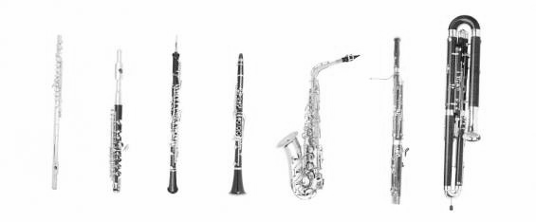
Woodwind Instruments Slide 3 of 3
Consider using material to create a shield at the end of your instrument’s bell. The most recent research suggests nylon or pantyhose material as the best material to use. If using pantyhose, cut the foot-end of the hose to the size of your instrument’s bell and ensure that there are no holes across the hose. The more layers of hose used, the more effective this method is at containing large and small particles. This may not be necessary for flute instruments. Consult with your band director if you are unsure of whether to take this step. Recent research is still pending on the efficacy of this method (Spahn & Richter, 2020a; UK Association for Music Education, 2020; Willich, et al., 2020; Kähler & Hain, 2020; Weaver, et al., 2020).
5 of 5
https://www.edu.xunta.es/ftpserver/portal/S_EUROPEAS/MUSIC/woodwind002.jpg

Slide 22

Brass Instruments Slide 1 of 4
Do not share music or folders, music stands, mouthpieces, valve oil, slide grease, mutes, or any other instrument-specific equipment (Spahn & Richter, 2020a; UK Association for Music Education, 2020; Indiana State Department of Health, et al., 2020; ISBE & IDPH, 2020; NFHS & NAfME, 2020)
6 feet (2 meters) of radial distancing is sufficient for all brass instruments, with the exception of trombones. An additional 3 feet (1 meter) of radial distance is required for trombones to accommodate for full extension of the main slide (UK Association for Music Education, 2020; Willich, et al., 2020; Hamner, et al, 2020; Kähler & Hain, 2020; Weaver, et al., 2020).
1-2 of 5

Slide 23
Brass Instruments Slide 2 of 4
Properly wear a face mask when not playing your instrument. When playing, simply slide the mask down onto your chin so that it is not covering your mouth or nose. When not playing (while the director is instructing, during rehearsal breaks, or any longer period of time when not playing) return to properly wearing the mask. Masks do not need to be worn for short periods of rest during music-making but do consider wearing during more extended passages of resting (West Point Research Center, 2020; Willich, et al., 2020; Clase, et al., 2020; Zhang, et al., 2020; Hamner, et al, 2020; Helfgott, 2020; Chu, et al., 2020; Weaver, et al., 2020; ISBE & IDPH, 2020). Consider having a face mask that you use while playing. Cut a small slit into this mask into which you can place your instrument’s mouthpiece while playing. When playing with a mask on, ensure that the mask still sits properly on your nose and upper cheeks. Recent research is still pending on the efficacy of this method (Weaver, et al., 2020).
3 of 5

Slide 24
Brass Instruments Slide 3 of 4
Do not drain any condensation from your instrument onto the floor. Use a small absorbent cloth that you wash regularly or use an absorbent, disposable pad that you can drain your instrument’s condensation on to. Do not share these absorbent materials with anyone else; dispose of any non-reusable products at the conclusion of rehearsal. Do not blow the condensation out of your instrument’s spit valves; simply drain what comes out from the instrument when the valve is released. When possible, do not drain condensation while at your seat, and instead wait to do so at your instrument’s case at the conclusion of rehearsal or during breaks. If your instrument requires draining while playing, avoid doing so frequently during rehearsal (Spahn & Richter, 2020a; UK Association for Music Education, 2020; West Point Research Center, 2020; Lebrecht, 2020; Willich, et al., 2020).
4 of 5

Slide 25
Brass Instruments Slide 4 of 4
Consider using material to create a shield at the end of your instrument’s bell. The most recent research suggests nylon or pantyhose material as the best material to use. If using pantyhose, cut the foot-end of the hose to the size of your instrument’s bell and ensure that there are no holes across the hose. The more layers of hose used, the more effective this method is at containing large and small particles. This is not necessary for flute instruments. Consult with your band director if you are unsure of whether to take this step. Recent research is still pending on the efficacy of this method (Spahn & Richter, 2020a; UK Association for Music Education, 2020; Willich, et al., 2020; Kähler & Hain, 2020; Weaver, et al., 2020).
5 of 5

Slide 26
Percussion & Keyboard Instruments Slide 1 of 3
Do not share instruments, mallets, music, music stands, or any other instrument-specific equipment (Spahn & Richter, 2020a; UK Association for Music Education, 2020; Indiana State Department of Health, et al., 2020; Willich, et al., 2020; ISBE & IDPH, 2020; NFHS & NAfME, 2020). Purchase a personal set of concert percussion mallets. Do not share these mallets with others. For more expensive or non-standard mallets, request that your band director provide mallets that will be exclusively your own to use. If sharing of mallets cannot be avoided, sanitize them before and after use, and before exchanging mallets with the next person (Willich, et al., 2020; ISBE & IDPH, 2020; NFHS & NAfME, 2020).
Musicians should each be assigned their own instrument(s). Do not share instruments. You will need to be responsible for moving your instrument(s) at the beginning and conclusion of rehearsal and maintaining 6 feet (2 meters) of distance while doing so (Spahn & Richter, 2020a; UK Association for Music Education, 2020; ISBE & IDPH, 2020; NFHS & NAfME, 2020).
1-2 of 6

Slide 27
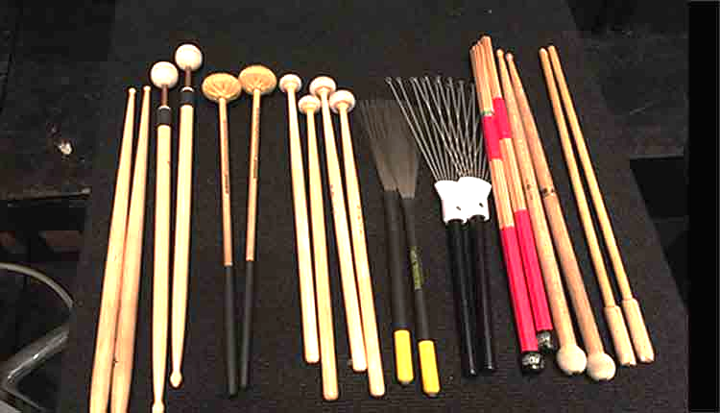
Percussion & Keyboard Instruments Slide 2 of 3
Wear gloves if you are playing shared instruments and/or mallets, and when moving instruments at the beginning and conclusion of rehearsal. Do not touch your face when wearing these gloves (Spahn & Richter, 2020a; Spahn & Richter, 2020b; ISBE & IDPH, 2020; NFHS & NAfME, 2020).
Wear a mask while playing your instrument (Spahn & Richter, 2020a; West Point Research Center, 2020; Willich, et al., 2020; Clase, et al., 2020; Zhang, et al., 2020; Hamner, et al, 2020; Helfgott, 2020; Chu, et al., 2020; Weaver, et al., 2020; ISBE & IDPH, 2020).
3-4 of 6

Slide 28
Percussion & Keyboard Instruments Slide 3 of 3
6 feet (2 meters) of distance should be maintained between musicians. The most effective method would be to space the instruments out 6 feet (2 meters) apart so that musicians maintain the proper distance at any point on the instrument. This is specifically pertinent to mallet instruments, where musicians move around the whole range of the instrument (Spahn & Richter, 2020a; Willich, et al., 2020; Willich, et al., 2020; Hamner, et al, 2020; Spahn & Richter, 2020b; Kähler & Hain, 2020; Chu, et al., 2020; Weaver, et al., 2020; ISBE & IDPH, 2020).
Disinfect instruments between uses. For pianos, use a disinfecting solution (see latest instrument cleaning guidelines) to sanitize piano keys before and after use. For all other percussion instruments, ensure that at the conclusion of rehearsal, you sanitize the instrument’s contact points where the instrument is handled for playing and for moving (Spahn & Richter, 2020a; UK Association for Music Education, 2020; West Point Research Center, 2020; Spahn & Richter, 2020b; ISBE & IDPH, 2020; NFHS & NAfME, 2020).
5-6 of 6

Slide 29
Resources (Slide 1 of 7)
Anderson, Elizabeth L., et al. “Consideration of the Aerosol Transmission for COVID‐19 and Public Health.” Risk Analysis, vol. 40, no.
5, 2020, pp. 902–907., doi:10.1111/risa.13500.
Brannon, Keith. “Early Study Shows Coronavirus Can Live in the Air over 16 Hours.” MedRxiv, 12 May 2020.
Chu, Derek K, et al. “Physical Distancing, Face Masks, and Eye Protection to Prevent Person-to-Person Transmission of SARS-CoV-2
and COVID-19: a Systematic Review and Meta-Analysis.” Elseview Enhanced Reader, 1 June 2020, doi:10.1016
Clase, Catherine M, et al. “Cloth Masks May Prevent Transmission of COVID-19: An Evidence-Based, Risk-Based Approach.” Annals
of Internal Medicine, U.S. National Library of Medicine, 8 June 2020, 10:54 AM, pubmed.ncbi.nlm.nih.gov/32441991/. Department of Homeland Security, 2020, Master Question List for COVID-19 (Caused by SARS-CoV-2).
.

Slide 30
Resources (Slide 2 of 7)
Doremalen, Neeltje Van, et al. “Aerosol and Surface Stability of HCoV-19 (SARS-CoV-2) Compared to SARS-CoV-1.” New England
Journal of Medicine, MED, no. 382, ser. 16, 16 May 2020. 16, doi:10.1101/2020.03.09.20033217.
Evans, M. (2020). Avoiding COVID-19: Aerosol Guidelines. 1-13. doi:10.1101/2020.05.21.20108894
Fears, Alyssa C, et al. “Comparative Dynamic Aerosol Efficiencies of Three Emergent Coronaviruses and the Unusual Persistence of
SARS-CoV-2 in Aerosol Suspensions.” 2020, doi:10.1101/2020.04.13.20063784.
Hamner, Lea, et al. U.S. Department of Health and Human Services, 2020, High SARS-CoV-2 Attack Rate Following Exposure at a
Choir Practice.
Helfgott, David C. “Respiratory Transmission of SARS-CoV-2: What Do We Really Know?” Infectious Disease Advisor, 23 Apr. 2020,
www.infectiousdiseaseadvisor.com/home/topics/covid19/respiratory-transmission-of-covid19-coronavirus/.

Slide 31
Resources (Slide 3 of 7)
High School Band Director's National Association (HSBDNA). (2020, May 26). Official Recommendation For the Maintenance and Continuation of Band Education in Our Nation's Schools During COVID-19 (Publication). Retrieved June, 2020, from High School Band Director's National Association website.
Illinois State Board of Education (ISBE), and Illinois Department of Public Health (IDPH). 2020, Starting the 2020-21 School Year Part 3 - Transition Joint Guidance.
Indiana State Department of Health, Indiana Department of Education, & Indiana Family & Social Services Administration. (2020, June 5). Indiana's Considerations for Learning and Safe School In-Class COVID-19 Health and Safety Re-entry Guidance (Rep.). Retrieved June, 2020, from State of Indiana website.
Kahler, Christian J., and Rainer Hain. Singing in Choirs and Making Music with Wind Instruments - Is That Safe during the SARS-CoV- 2 Pandemic? Institute of Fluid Mechanics and Aerodynamics, University of the Bundeswehr, 2020.

Slide 32
Resources (Slide 4 of 7)
Lebrecht, Norman. “A Full Assessment of the Covid Risk of Playing Wind Instruments.” Slipped Disc, 11 June 2020,
slippedisc.com/2020/06/a-full-assessment-of-the-covid-risk-of-playing-wind-instruments/.
Liu, et al. Aerodynamic analysis of SARS-CoV-2 in two Wuhan hospitals. Nature. https://doi.org/10.1038/s41586-020-2271-3 (2020).
Morawska, L., Tang, J. W., Bahnfleth, W., Bluyssen, P. M., Boerstra, A., Buonanno, G., . . .Yao, M. (2020). How can airborne transmission of COVID-19 indoors be minimised? Environment International, 142, 105832. doi:10.1016/j.envint.2020.105832
Miller, Shelly. “Coronavirus Drifts through the Air in Microscopic Droplets – Here's the Science of Infectious Aerosols.” The
Conversation, 2 May 2020, theconversation.com/coronavirus-drifts-through-the-air-in-microscopic-droplets-heres-the-science-of-infectious-aerosols-136663
Miller, S., Vance, M., & Hertzberg, J. (2020). Statement of Work: Aerosol Generation from Playing Band Instruments and Risk of
Infectious Disease Transmission [White paper]. University of Colorado Boulder.
Miller, S., Vance, M., & Hertzberg, J., Toohey, D., (2020). Statement of Work: Aerosol Generation from Playing Band Instruments,
Singing and Performing and Risk of Infectious Disease Transmission [White paper]. University of Colorado Boulder.

Slide 33
Resources (Slide 5 of 7)
National Federation of State High School Associations (NFHS), and National Association for Music Education (NAfME). 2020, Fall
2020 Guidance for Music Education.
Nishiura, Hiroshi, et al. “Closed Environments Facilitate Secondary Transmission of Coronavirus Disease 2019 (COVID-19).” 2020,
doi:10.1101/2020.02.28.20029272.
Qian, Hua, et al. “Indoor Transmission of SARS-CoV-2.” 2020.
Spahn, C., and Richter, B. (2020, May 19). Risk Assessment of a Coronavirus Infection in the Field of Music [Scholarly project]. In
Universitats Klinikum Freiburg. Retrieved June, 2020.
Spahn, Claudia, and Richter, B. “Risk Assessment Regarding Corona-Infections in Music Making.” Conductors Guild, 30 Apr. 2020,
www.conductorsguild.org/2020-coronavirus.
UK Association for Music Education (2020, June 2). Guidance for Providers. Retrieved June 2020, from https://www.musicmark.org.uk

Slide 34
Resources (Slide 6 of 7)
Vienna Philharmonic. (2020, May 18). Aerosol emission test: Low risk of infection due to the spread of breathing air from musicians
(Rep.). Retrieved June, 2020, from Vienna Philharmonic website.
Weaver, James, et al. National Federation of State High School Associations, 2020, Preliminary Recommendations from International
Performing Arts Aerosol Study Based on Initial Testing Results, nfhs.org/media/4029971/preliminary-recommendations-from-international-performing-arts-aerosol-study.pdf.
West Point Music Research Center. (2020, June 8). Army Band Operational Procedures Within a COVID-19 Environment (Rep.).
Retrieved June, 2020, from West Point Music Research Center website: https://www.westpointband.com/documents/ANNEX-C-Army-Band-COVID-19-Operational-Guidelines.pdf
Willich, Stefan N., et al. Charite, 2020, Policy Brief about Performances of Orchestras during the COVID-19 Pandemic.

Slide 35
Resources (Slide 7 of 7)
Volckens, J., Goble, D., Phillips, R., Henry, C., & Pidcoke, H. (2020). Reducing Bioaerosol Emissions and Exposures in the Performing
Arts: A Scientific Roadmap for a Safe Return from COVID19 [White paper]. Colorado State University.
Zhang, Renyi, et al. “Identifying Airborne Transmission as the Dominant Route for the Spread of COVID-19.” Proceedings of the
National Academy of Sciences of the United States of America, 14 May 2020, doi:10.1073.
Zhao, Lei, et al. “COVID-19: Effects of Weather Conditions on the Propagation of Respiratory Droplets.” 2020,
doi:10.1101/2020.05.24.20111963.

