Slide 1

The Analysis of Narrative Intervention with A Bilingual Spanish-English Speaking Adolescent with Down Syndrome
Lindsay Piña Garcia
Mentor: Dr. Brenda Gorman

Slide 2
Background
Terms to note:
Macrostructure (story components)
Microstructure (Vocab and grammar)
Cross-linguistic transfer (the ability for the participant of applying what they learned in one language to the other language)
Purpose:
This study was designed to analyze the macrostructure, microstructure, and cross-linguistic transfer in a bilingual (Spanish-English) adolescent with Down syndrome throughout a narrative language intervention.

Slide 3
Hypothesis
1. The participant will demonstrate transfer
2. There will be more robust cross-linguistic transfer of macrostructural (story components) skills than microstructural skills (grammar and vocab)

Slide 4
Methods
Participant
15 year 11-month-old Spanish-English bilingual female with Down Syndrome
Academic instruction in English
Home-language Spanish
15 narrative intervention sessions transcribed and analyzed
Language of intervention was alternated to analyze transfer
Language samples were retrospectively examined using four tools:
Narrative Language Measures (NLM)
the Narrative Scoring Scheme (NSS)
Narrative Assessment Protocols English and Spanish (NAP-S)
Over 30 variables analyzed

Slide 5
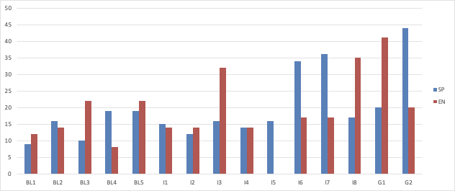
Narrative Scoring Scheme (Macrostructure)
Note: Blue= Spanish; Red: English; B = Baseline; I = Intervention; G = Generalization; TNL = Test of Narrative Language; NLM = Narrative Language Measure.
Language of Instruction: =Spanish Instruction =English Instruction

Slide 6
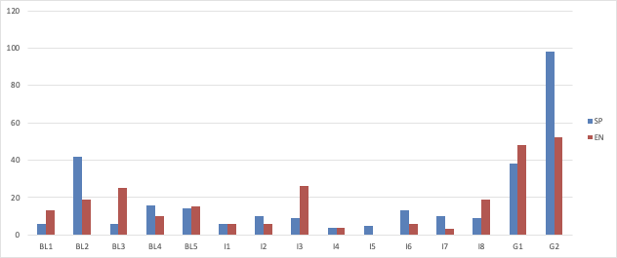
Narrative Assessment Protocol-Spanish and English (Microstructure)
Note: Blue= Spanish; Red: English; B = Baseline; I = Intervention; G = Generalization; TNL = Test of Narrative Language; NLM = Narrative Language Measure.
Language of Instruction: =Spanish Instruction =English Instruction

Slide 7
Results
Transfer in all areas assessed
Notable macrostructural and microstructural gains in both languages
Robust cross-linguistic transfer of macrostructural skills
Transfer was slightly greater when instruction was provided in Spanish
3. Important aspects of narrative language skills captured:
NSS
Transfer in all areas, stronger Spanish skills; 55% of probes were higher.
NAP-S
Personal narrative score increased after the treatment, 56% higher skills in Spanish

Slide 8


Discussion
The current study demonstrates bilingual learning ability despite intellectual impairment and benefits of narrative language intervention
Results also enhance professionals' understanding of the micro- and macro structural skills in a bilingual participant with Down syndrome
Participants abilities in both language is impressive (no visual supports)
Clearly provides evidence that contradicts the misconception that individuals with DS cannot handle the demands of both languages
Children with disabilities should never be denied the opportunity to learn more than one language and in fact they clearly benefit

Slide 9
References
Barton-Hulsey, A., Sevcik, R. A., & Romski, M. (2017). Narrative language and reading comprehension in students with mild intellectual disabilities. American Journal on Intellectual and Developmental Disabilities, 122 (5), 392–408. https://doi.org/10.1352/1944-7558-122.5.392
Boudreau, D. (2002). Literacy skills in children and adolescents with Down syndrome. Reading and Writing, 15, 497–525. https://doi.org/10.1023/A:1016389317827
Chapman, R.S., Seung, H., Schwartz, S.E., & Bird, E.K. (1998). Language skills of children and adolescents with Down syndrome. Journal of Speech, Language & Hearing Research, 41 (4), 861-873. https://doi.org/10.1044/jslhr.4104.861
Cleave, P., Kay-Raining Bird, E., Czutrin, R., & Smith, L. (2012). A longitudinal study of narrative development in children and adolescents with Down syndrome. Intellectual and Developmental Disabilities, 50 (4), 332-342. https://doi.org/10.1352/1934-9556-50.4.332
Grasso, S.M., Pena, E.D., Bedore, L.M., Hixon, J.G., & Griffin, Z.M. (2018). Cross-linguistic cognate production in Spanish-English bilingual children with and without specific language impairment. Journal of Speech, Language, and Hearing, 61, (619-633). https://doi.org/10.1044/2017_JSLHR-L-16-0421

Slide 10
References
Hessling, A., & Brimo, D.M., (2019). Spoken fictional narrative and literacy skills of children with Down syndrome, 79, 76-89. https://doi.org/10.1016/j.jcomdis.2019.03.005
Kay-Raining Bird, E., Chapman, R., & Schwartz, S. (2004). Fast-mapping of words and story recall by children with Down syndrome. J Speech Lang Hear Res, 47, 1286–1300. https://doi.org/10.1044/1092-4388(2004/097)
Kay-Raining Bird, E., Cleave, P., Trudeau, N., Thordardottir, E., Sutton, A., & Thorpe, A. (2005). The language abilities of bilingual children with Down syndrome. American Journal of Speech-Language Pathology, 14, 187-199. https://doi.org/10.1044/1058-0360(2005/019)
Miles, S., & Chapman, R. S. (2002). Narrative content as described by individuals with down syndrome and typically developing children. Journal of Speech Language and Hearing Research, 45, 175–189. https://doi.org/10.1044/1092-4388(2002/013)
Miller, J., Iglesias, A., Heilmann, J., Fabiano, L., Nockerts, A., & Francis, D. (2006). Oral language and reading in bilingual children. Learning Disabilities Research and Practice, 21(1), 30–43. https://doi.org/10.1111/j.1540-5826.2006.00205.x

Slide 11
References
Orizaba, L., Gorman, B.K., Fiestas, C.E., Bingham, G.E., & Paton-Terry, N. (2020). Language, Speech, and Hearing Services in Schools. Examination of narrative language at microstructural and macrostructural levels in spanish-speaking preschoolers. 1-13. https://doi.org/10.1044/2019_LSHSS-19-00103
Peterson, D.B. (2011). A systematic review of narrative-based language intervention with children who have language impairment. Communication Disorders Quarterly, 32(4), 207-220. https://doi.org/10.1177/1525740109353937
Peterson, D.B., & Spencer, T.D. (2012). The Narrative Language Measures: tools for language screening, progress monitoring, and intervention planning. Perspectives on LanguageLearning and Education, 19(4), 119-129. https://doi.org/10.1044/lle19.4.119
Roberts, J.E., Price, J., & Malkin, C. (2007). Language and communication development in Down syndrome. Mental Retardation and Developmental Disabilities Research Reviews, 13 (1), 26-35. https://doi.org/10.1002/mrdd.20136

Slide 12
References
Segal, A., & Pesco, D. (2015). Narrative skills of youth with Down syndrome: acomprehensive literature review. Journal of Developmental and Physical Disabilities, 27, 721–743. https://doi.org/10.1007/s10882-015-9441-5
Spencer, T.D., Kajian, M., Peterson D.B., & Bilyk, N. (2013). Effects of an individualized narrative intervention on children’s storytelling and comprehension skills. Journal of Early Intervention, 35 (3), 243-269. https://doi.org/10.1177/1053815114540002
Stein, N., & Glenn, C. (1979). An analysis of story comprehension in elementary school 162 children. In R. Freedle (Ed.), New directions in discourse processing, 53- 120. Norwood, NJ: Ablex.
Squires, J.E., Graham, I.D., Hutchinson, A.M. et al. (2015) Identifying the domains of context important to implementation science: a study protocol. Implementation Sci 10, 135. https://doi.org/10.1186/s13012-015-0325-y
Uccelli, P., & Paz, M. (2007). Narrative and vocabulary development of bilingual children from kindergarten to first grade: developmental changes and associations among English and Spanish skills. American Speech-Language-Hearing Association, 38 (3), 225-236. https://doi.org/10.1044/0161-1461(2007/024)

