Slide 1

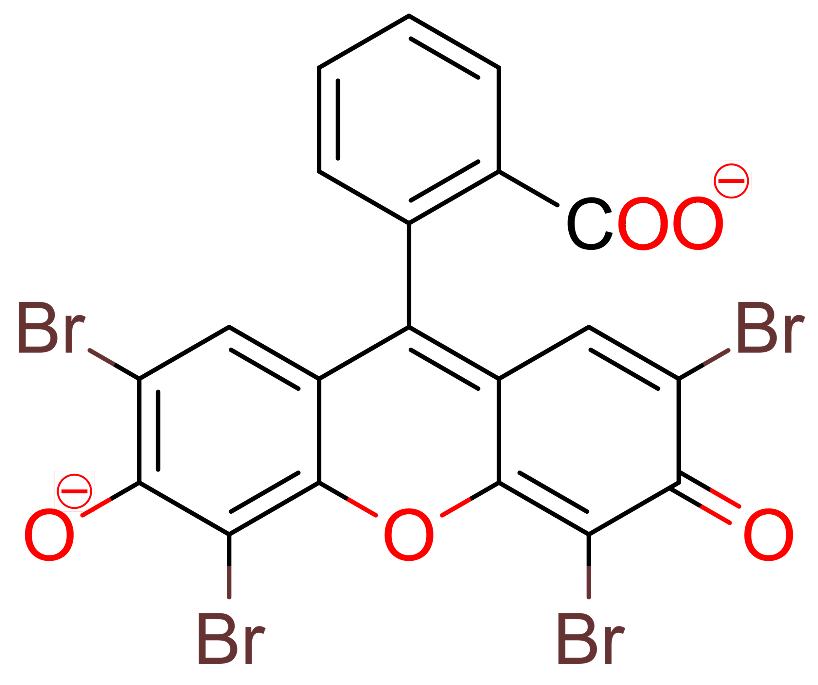
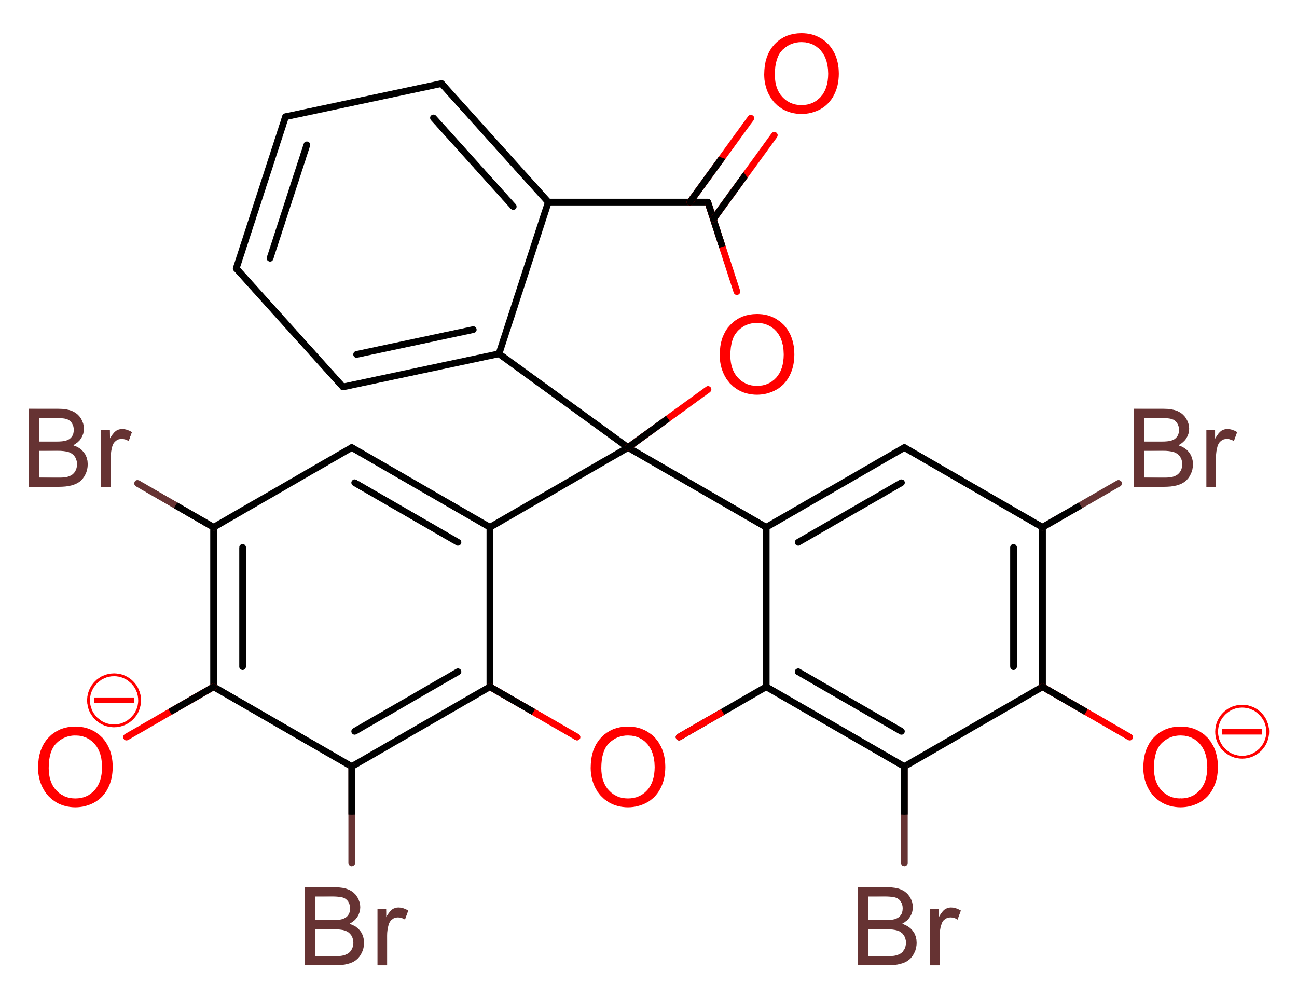
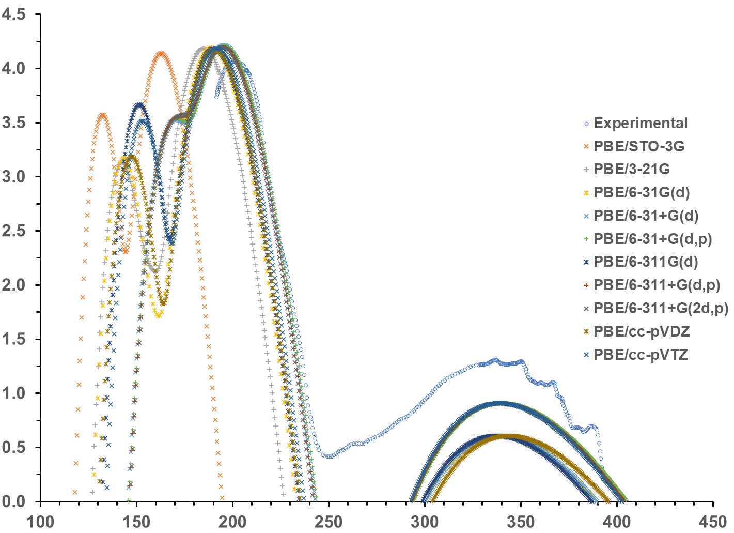
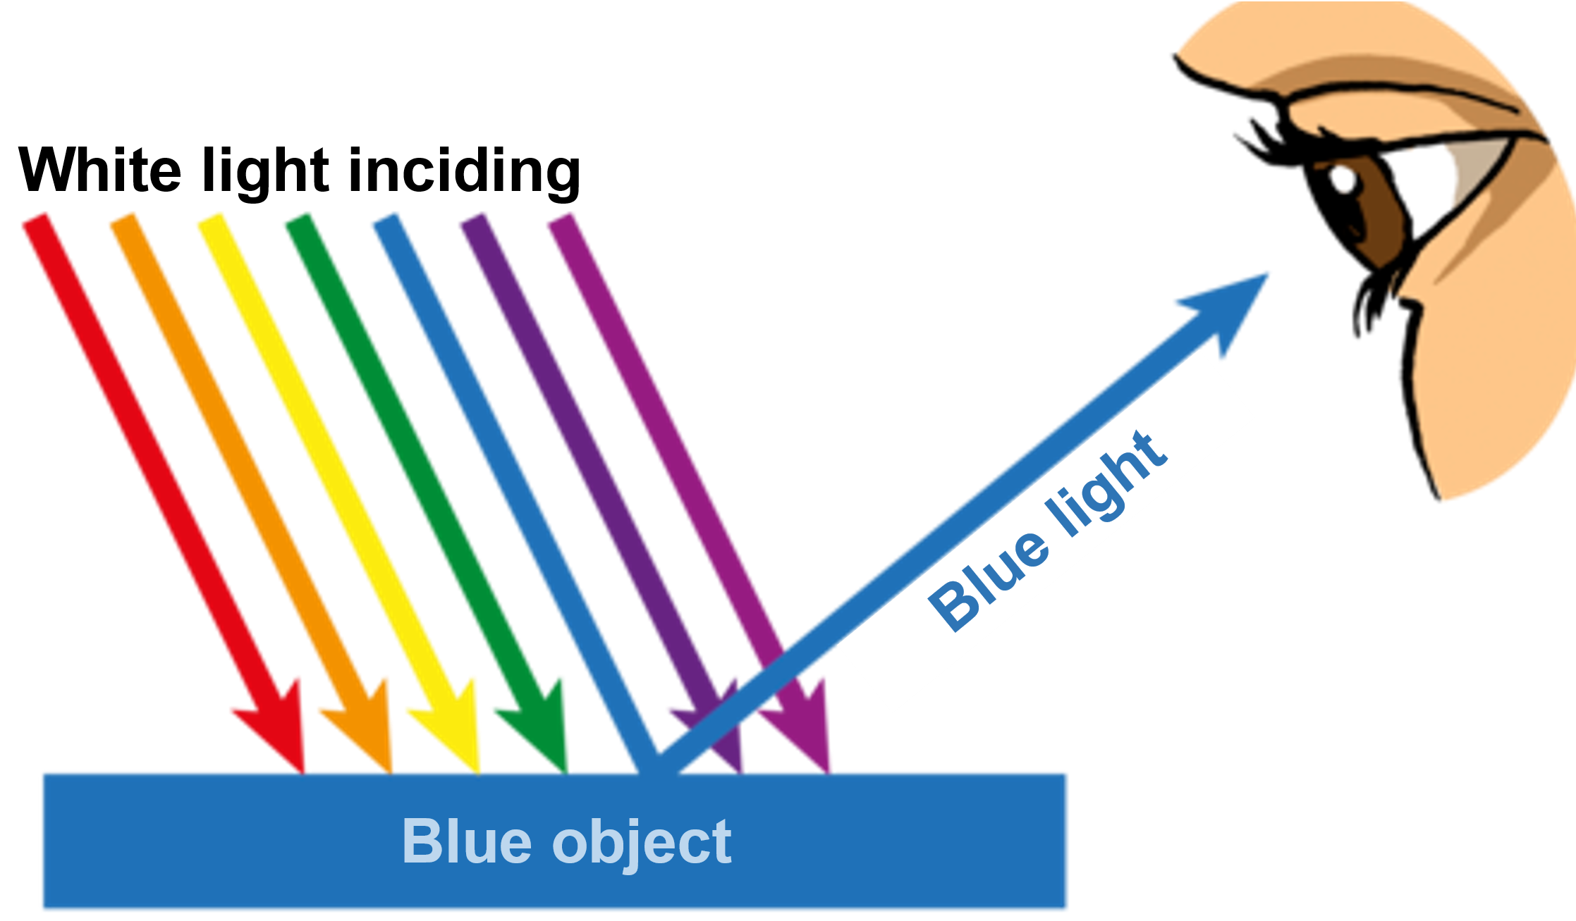
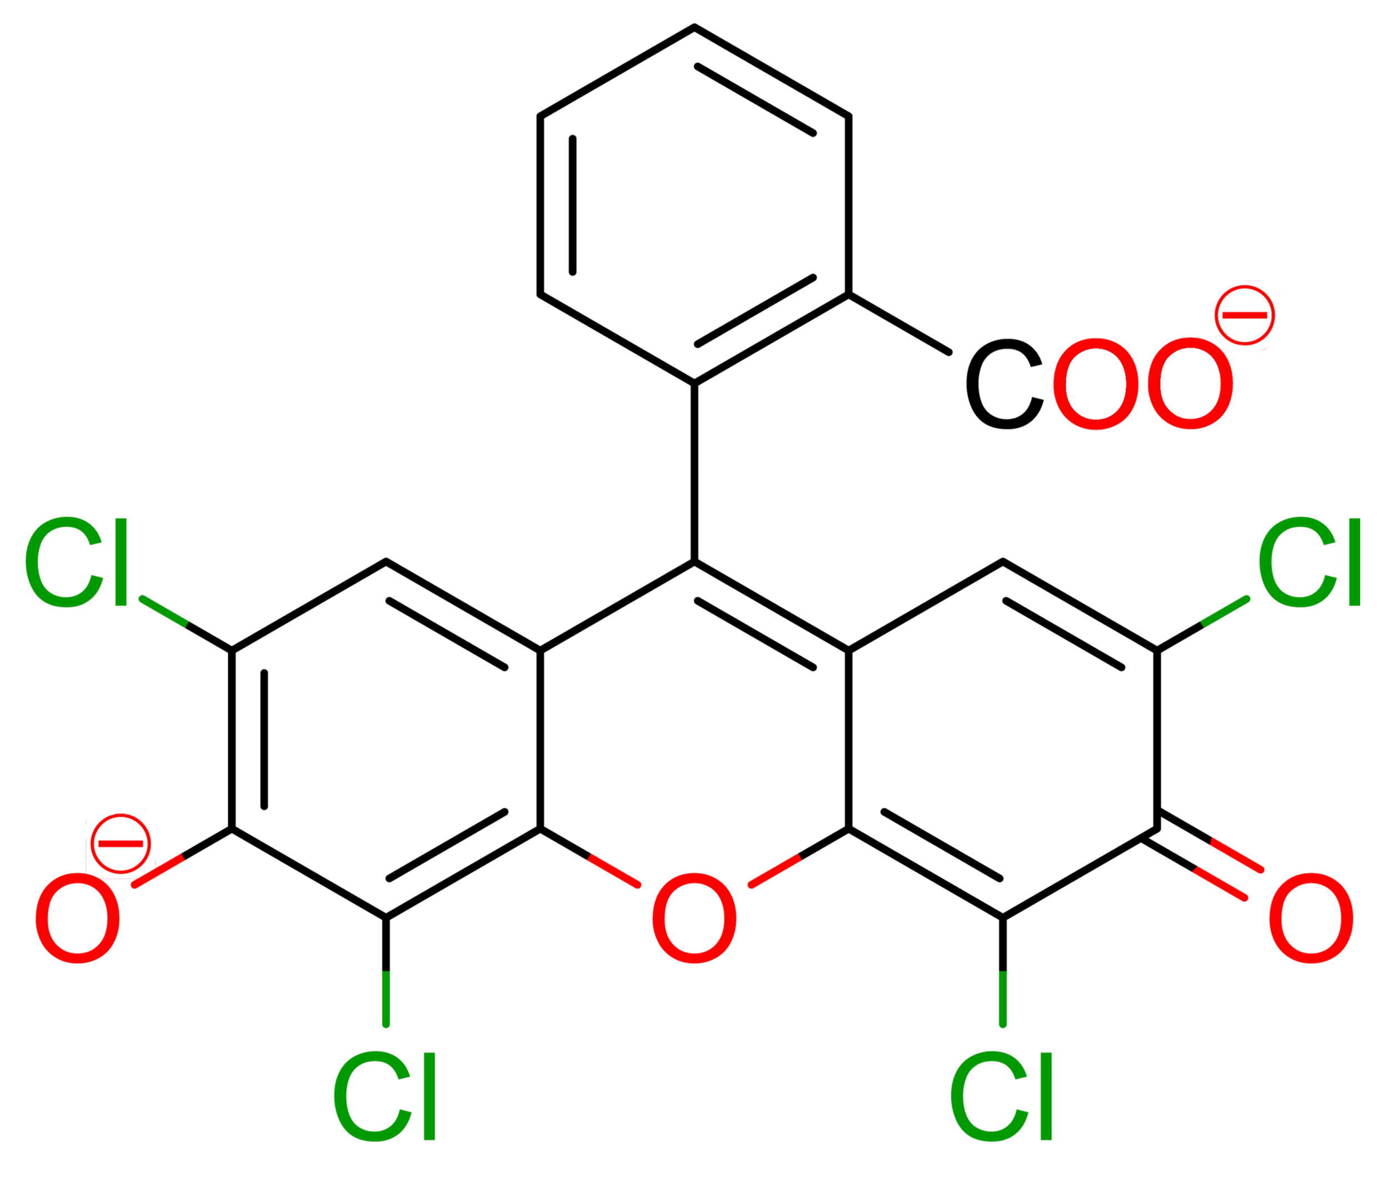
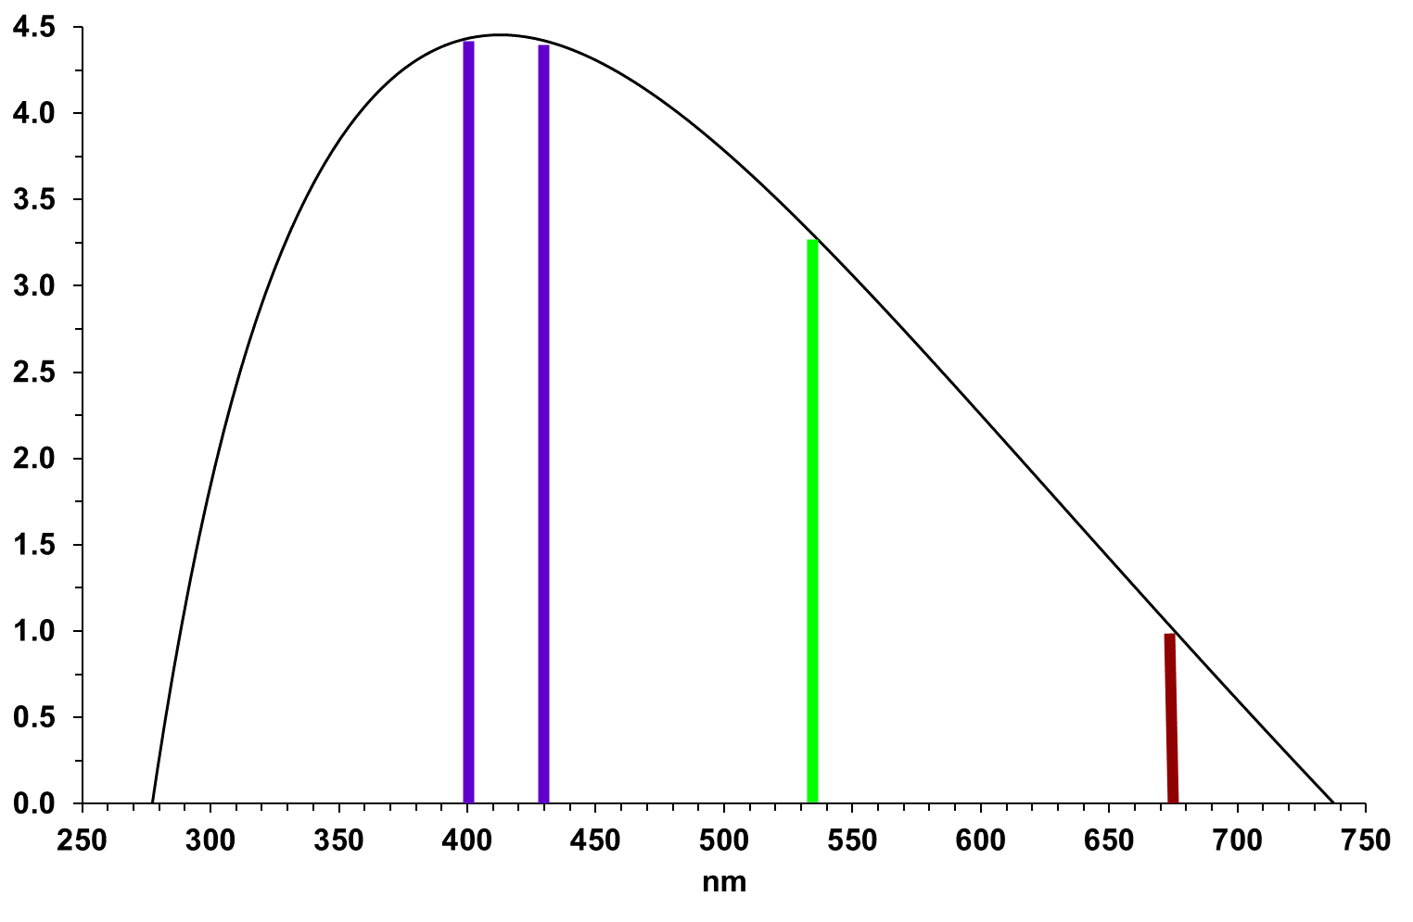
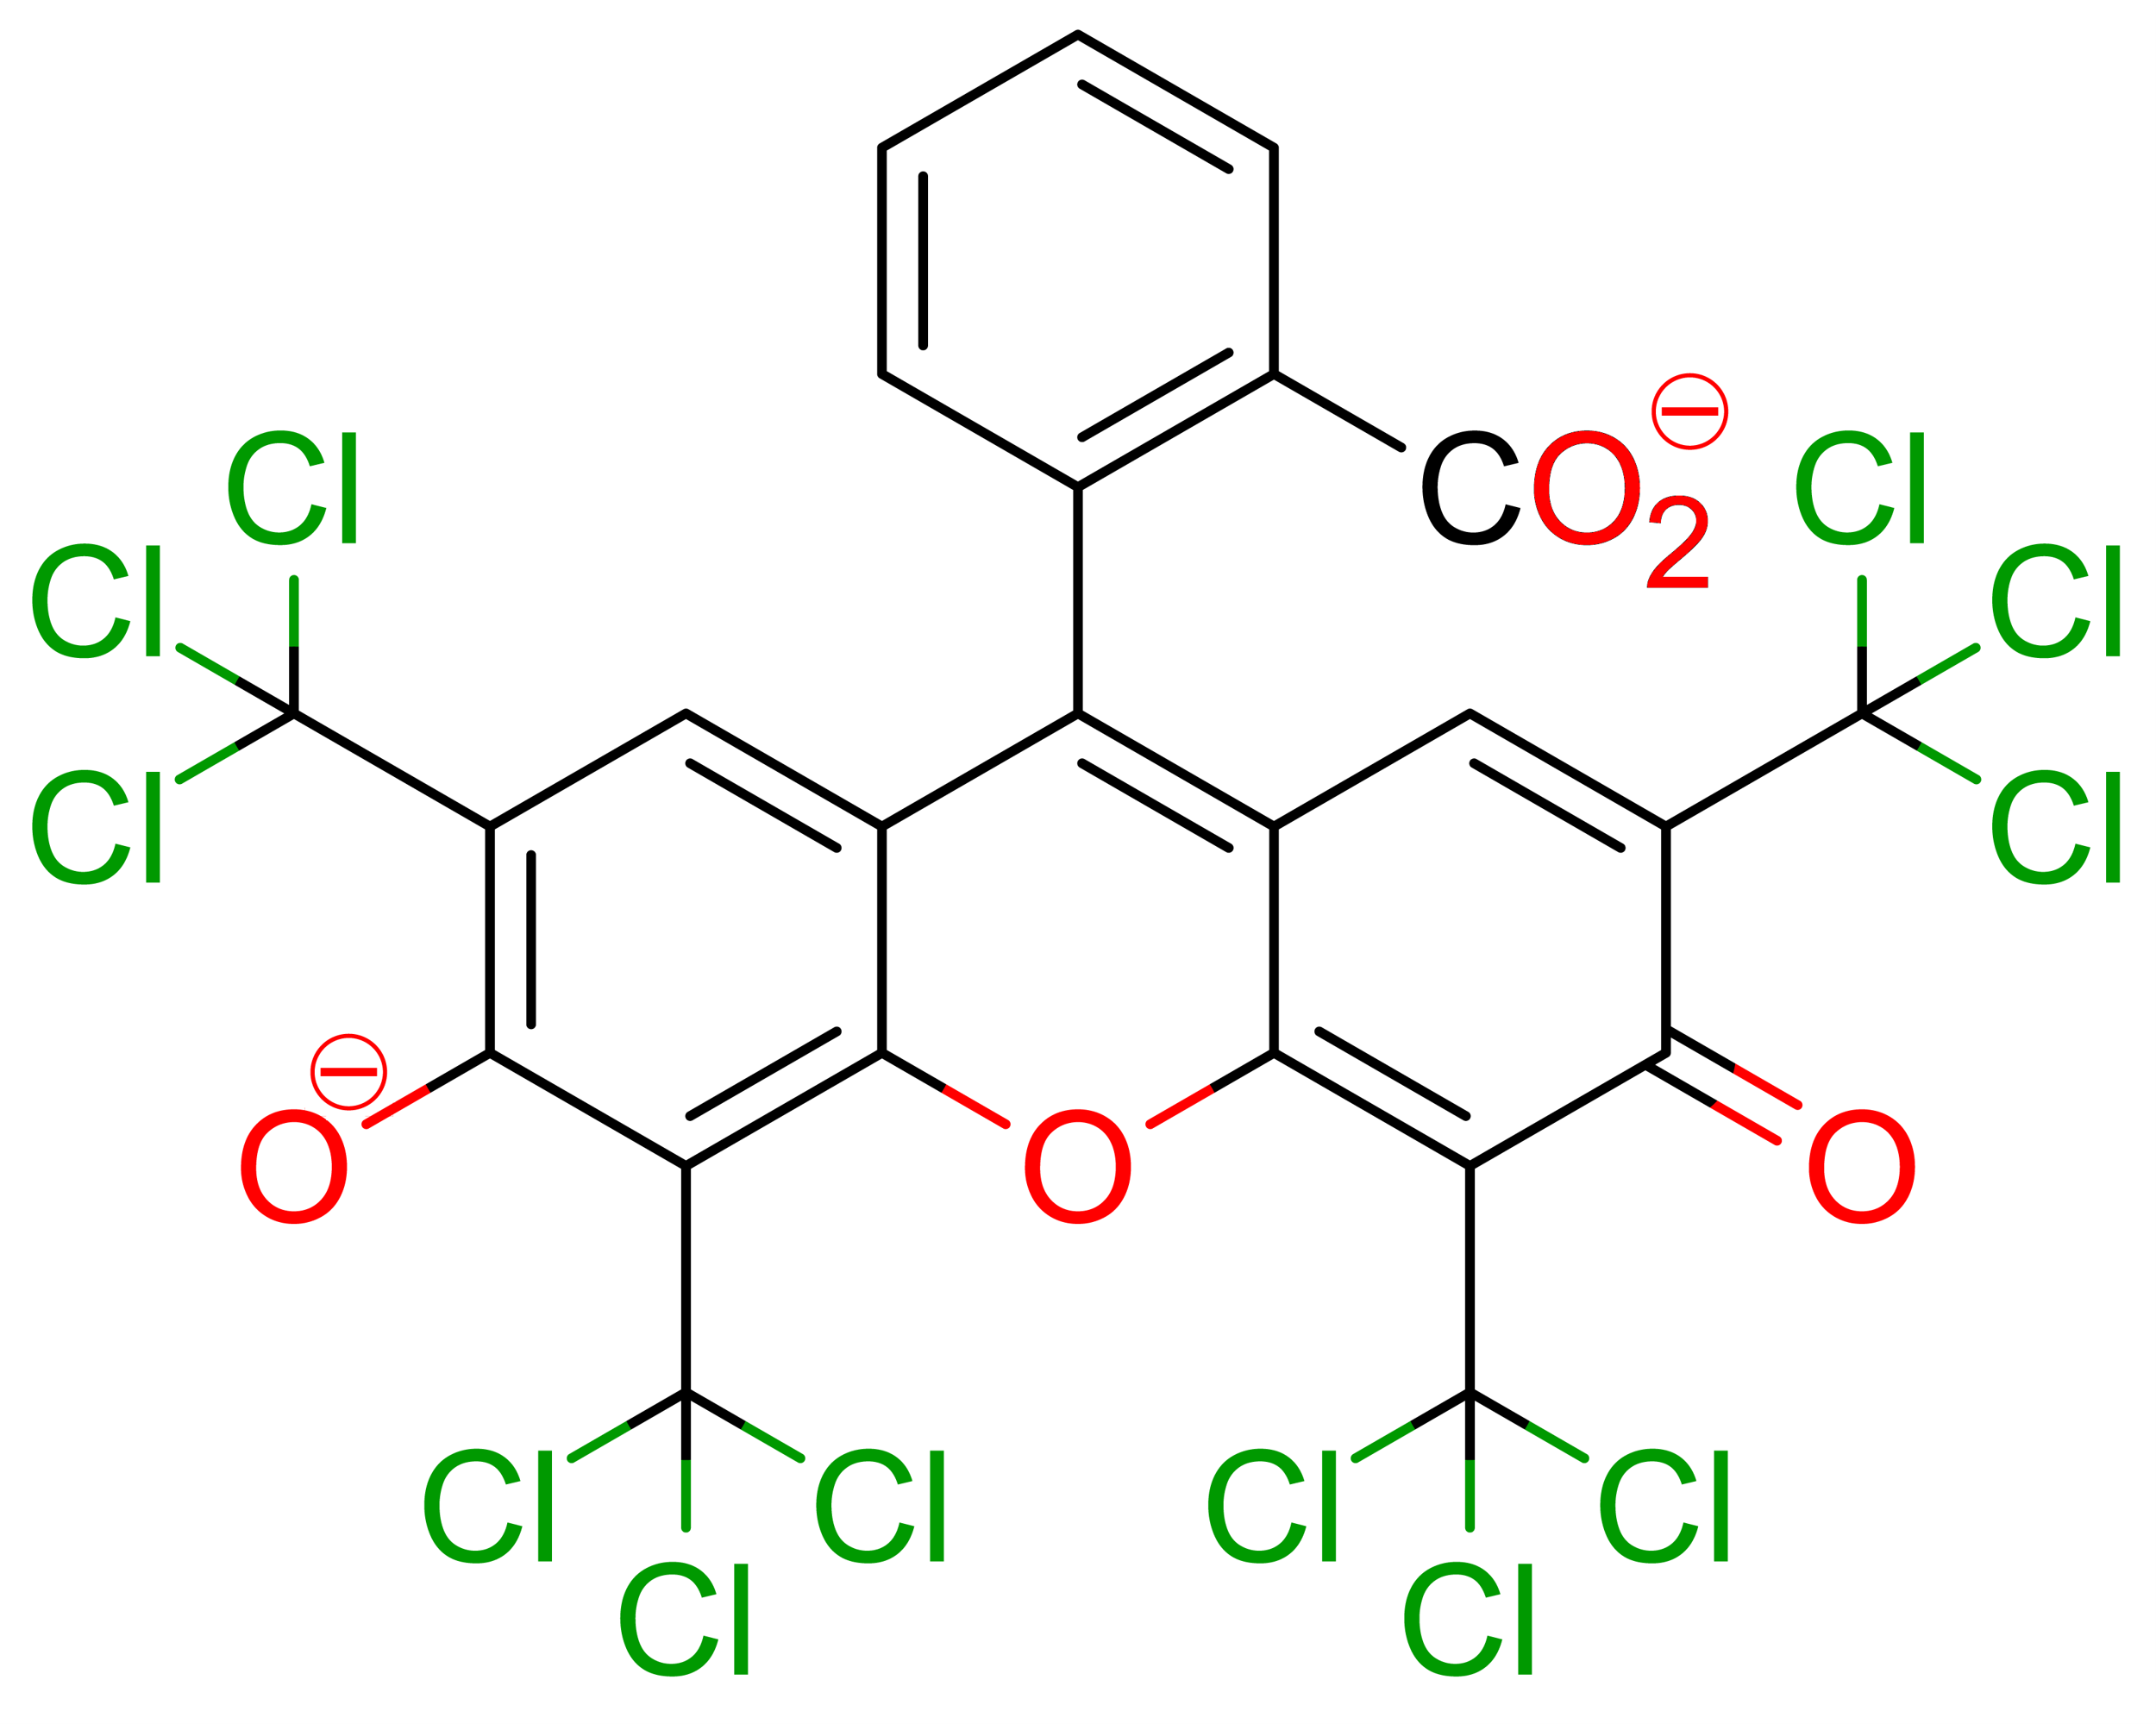
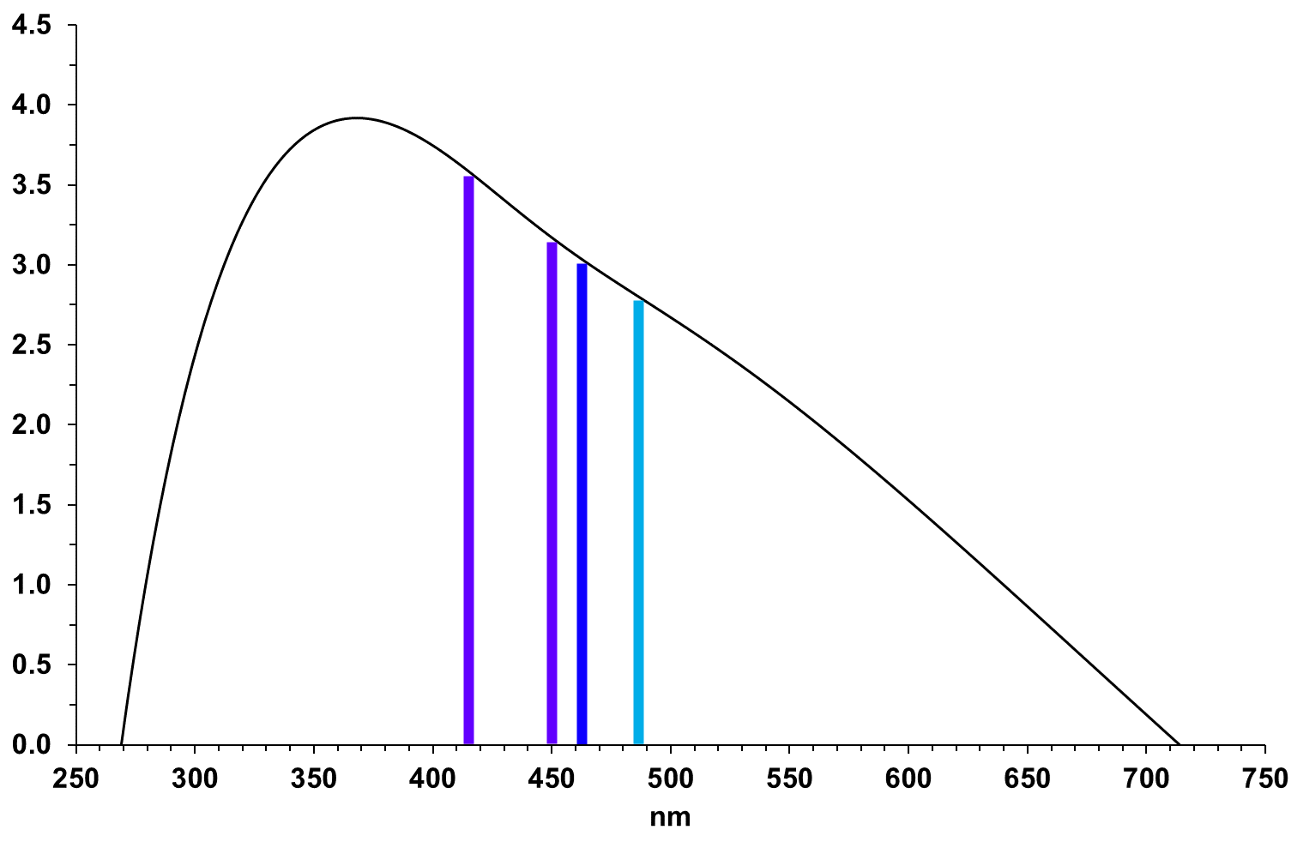
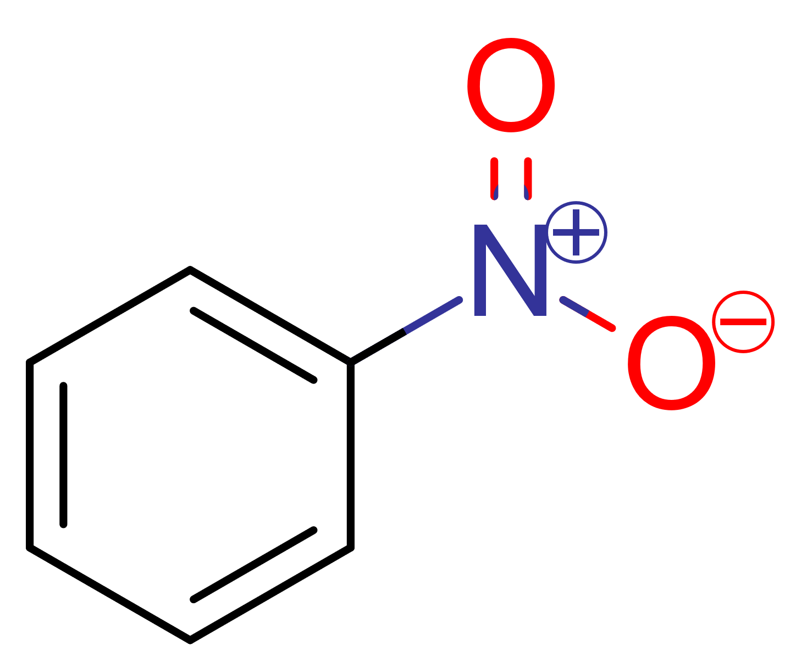
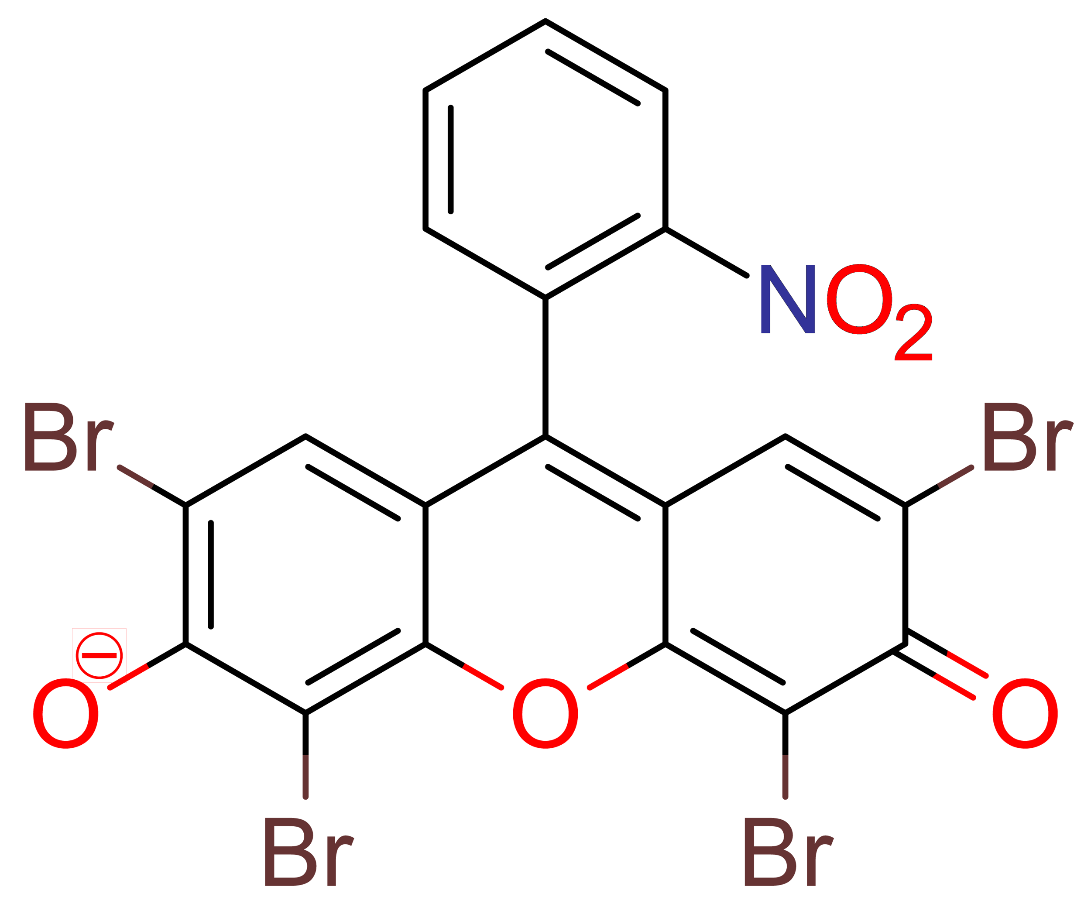
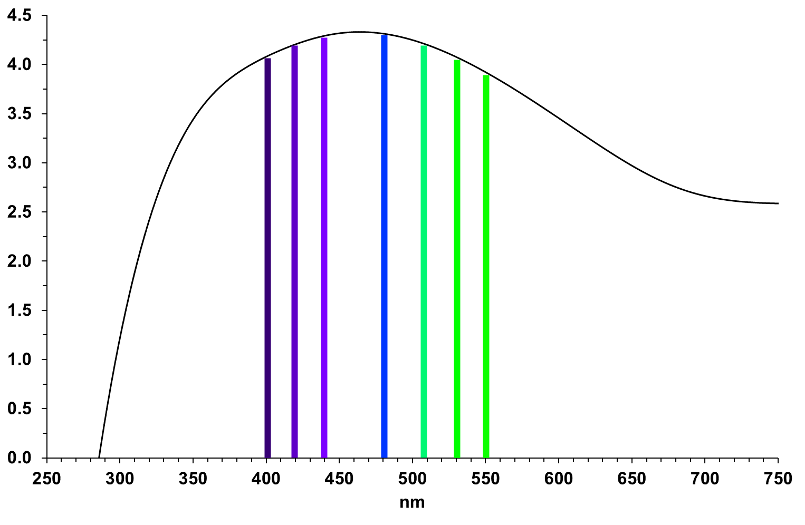
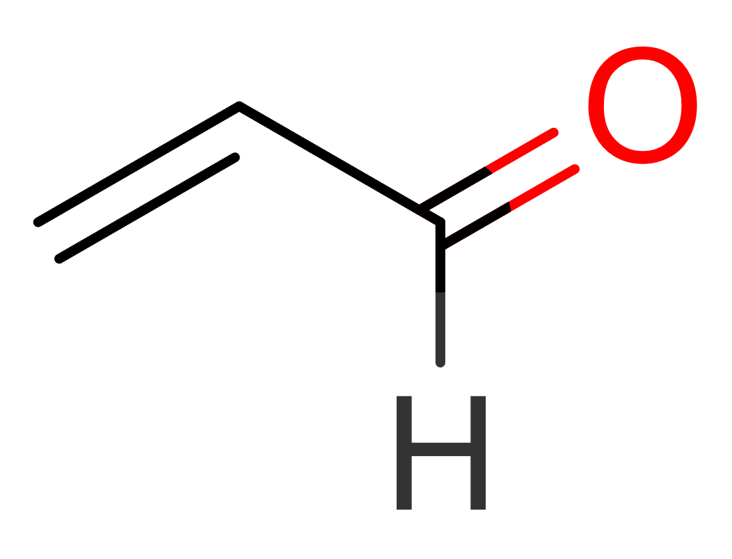
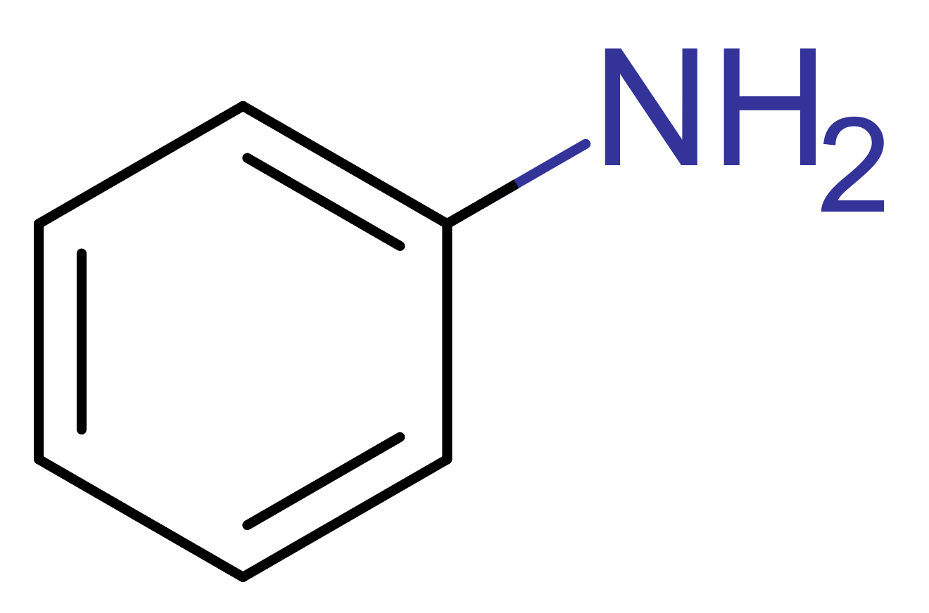
On The Colour of Fountain Pen Inks
ªKaitlin Krivak, ªCarlos Romero and ^{b}Álvaro Castillo, Ph.D.
ªDepartment of Physics. ^{b}Department of Chemistry & Biochemistry, Elmhurst University, Elmhurst, IL 60126
INTRODUCTION
RESULTS AND DISCUSSION (Cont.)
ON THE COLOUR OF EOSIN Y
The electromagnetic spectrum is a type of radiation. Radiation is energy emitted in the form of light waves or photon particles that have different frequencies, and it is a small section of this spectrum (420 - 700 nm) that humans can perceive as colour. Fountain pen ink has been used throughout history as a way of documentation. It has survived the test of time despite the introduction of more modern writing instruments, such as ballpoint and rollerball pens. Although fountain pen ink can be composed of pigments, dyes, or a combination of the two, this study focuses on one dye molecule, eosin Y. Observed colour is an interesting phenomena as it is the result of the interaction of light with matter in a rather counterintuitive way. The colour we observe is the result of the “removal” (absorption) of the colours not seen. (Figure 1).
As proof of concept the spectra for acrolein was also compared with the experimental spectrum as reported by the National Institute of Standards and Technology (NIST). Our results are depicted in figure 3.
Despite many efforts, our calculations for Eosin Y (structure 4a) where not successful, all our attempts yielded a closed structure for eosin Y (structure 4b) that was predicted to be colourless. This surprised us however it is not the first report dealing with this form of the molecule and its lack of colour. Mchedlov-Petrosyan, N. O.; Kukhtik, V. I.; Egorova, S. I. Russ. J. Gen. Chem. 2006, 76, 16017-1617.
4a
Figure 4: Two possible structures for eosin Y.
4b
ON THE COLOUR OF TETRACHLORO-EOSIN Y
Our calculations for an eosin Y molecule in which all bromine atoms are substituted by chlorine atoms predict that this compound will absorb purple (400 - 429 nm), green (534 nm) and slightly dark red (675 nm) light so it would be orange-yellow in colour.
Figure 1: Absorption of light grants objects their characteristic colours.
When a sample interacts with light, any absorbed light is converted to energy and a higher energy state is achieved (an excited state) since in general, matter tends to be in its lowest energy state (the ground state), knowing this energy difference is crucial to determine the type of light that will interact with a sample. This study utilized quantum mechanical calculations to determine the energies of those two states and thus predict what colours of light would be exhibited by eosin Y and three of its derivatives (slightly modified structures) figures 4 to 7.
nm
5
Figure 3: Calculated vs. experimental UV-VIS spectra for acrolein (gas).
Figure 5: Structure of the chlorinated variant of eosin Y and its PBE/6-31G(d)
Our calculations are in good agreement with the experimental spectrum for acrolein. To study the effect of the solvent, calculations were conducted using the Polarizable Continuum Model (PCM) with water as the solvent. These calculations were carried out only with the DFT methods and only with the 6-31+G(d,p), 6-311+G(2d,p) and cc-pVTZ basis sets. In this case the most accurate method is PBE/6-31+G(d) with an error of only 0.6%, followed by PBE/cc-pVTZ being off by 3.1% and lastly PBE/6-311+G(2d,p) with 4.0% error. A caveat is worth mentioning here: NIST does not report the solvent for their data so a direct comparison was not possible.
ON THE COLOUR OF TETRATRICHLOROMETHYL-EOSIN Y
CALCULATION DETAILS
Calculations were performed with the Gaussian 09 suite of programs. Hartree-Fock and three Density Functional Theory (DFT) methods (CAM-B3LYP, PBE and PBE0) were employed for both geometry optimizations and critical point characterization. All structures were determined to be minima in the potential energy surface. The basis sets STO-3G, 3-21G, 6-31G(d), 6-31+G(d,p), 6-311G(d), 6-311G+(d,p), 6-311G+(2d,p), cc-pVDZ and cc-pVTZ were used for the calculations. Excitation energies where calculated for the methods described and determined for both singlets and triplets. Frank-Condon analysis for all methods where carried out only for acrolein due to the long times required for excited state numerical frequency calculations.
Determining A Suitable Calculation Method: In order to study colour properties in eosin Y and several derivatives, it is first important to find a method that is accurate, precise and efficient for this task (efficiency here considered as the time required for the calculation). Model compounds: acrolein (1), aniline (2), and nitrobenzene (3) were studied as probes to explore the accuracy of the calculation methods.
Our calculations for an eosin Y molecule in which all bromine atoms are substituted by tetrachloromethyl groups predict that this compound will absorb purple (416 - 450 nm), and blue (463 - 487 nm) light so it would be reddish in colour.
6
Figure 6: Structure of the tetratrichloromethylated variant of eosin Y and its PBE/6-31G(d)
ON THE COLOUR OF NITRO-EOSIN Y
Table 2: Calculated absorption bands (in nm) for aniline 2 in the gas phase.
Our calculations for an eosin Y molecule in which all bromine atoms are substituted by tetrachloromethyl groups predict that this compound will absorb purple (416 - 450 nm), and blue (463 - 487 nm) light so it would be also dark reddish in colour.
The same analysis was also carried out for aniline and nitrobenzene, our results can be found in tables 2 and 3 respectively. Combining the results for these three methods the situation inverts and the most accurate method becomes PBE/cc-pVTZ with an error of 2.5%. However the other two methods follow closely at 1% intervals.
1
2
3
Figure 2: Acrolein 1, aniline 2 and nitrobenzene 3 were used to explore method accuracy.
7
RESULTS AND DISCUSSION
Figure 7: Structure of the nitrated form of eosin Y and its PBE/6-31G(d)
Table 1 shows the calculated absorption bands for model compound 1 (gas phase) with the different methods of this study. The most accurate method with an average error of 4.4% is PBE/6-31+G(d,p).
CONCLUSIONS
This study used quantum mechanical calculations (DFT) to find an affordable method to study the colour properties of fountain pen dye molecules and some of their derivatives.
Our calculations indicate that substituting the bromine atoms in eosin Y with chlorine atoms alters its colour from orange to yellow – orange. Switching the bromine atom with CCl₃ moieties changes the colour to red.
Finally replacing the carbonyl group in eosin Y with a nitro group would make the compound dark reddish in colour.
Table 3: Calculated absorption bands maxima (in nm) for nitrobenzene 3 in the gas phase.
ACKNOWLEDGEMENTS
Creative and Scholarly Endeavors (CASE) Program at Elmhurst University.
Dean Jensen, Ed.D., MBA, Assistant Professor Department of Computer Science and Information Systems, Elmhurst University.
James Fitzgerald, MBA, Director of Technology Support Services, Office of Information Services, Elmhurst University.
CALCULATIONS ON EOSIN Y
REFERENCES
Although our results for model compounds 1 – 3 indicate that the most accurate method of calculation is PBE/cc-pVTZ, this method proved prohibitively slow when applied to eosin Y and its derivatives. For this compounds we could only afford the 6-31G(d) basis set that yielded and error of 4.6% for acrolein in the gas phase.
Quartarolo, A., Russo, N. A Computational Study (TDDFT and RICC2) of the Electronic Spectra of Pyranoanthocyanins in the Gas Phase and Solution. J. Chem. Theory Comput. 2011, 7, 1073-1081.
Jacquemin, D., Perpète, E., Scuseria, G., Ciofini, I., Adamo, C. TD-DFT Performance for the Visible Absorption Spectra of Organic Dyes: Conventional versus Long-Range Hybrids. J. Chem. Theory Comput. 2008, 4, 123-135.
Martín-Gil, J., Ramos-Sánchez, M., Martín-Gil, F., José-Yacamán, M. Chemical Composition of a Fountain Pen Ink. J. Chem. Educ. 2006, 83, 1476-1478.
Mchedlov-Petrosyan, N., Kukhtik, V., Egorova, S. Protolytic Equilibria of Fluorescein Halo Derivatives in Aqueous-Organic Systems. Russ. J. Gen. Chem. 2006, 76, 1607-1617.
Table 1: Calculated absorption bands maxima (in nm) for acrolein 1 in the gas phase.

